Slide 1
The Burden of Depression in General Practice
Dr.Tarek Asaad
Prof. of Psychiatry, Ain Shams University
Director of Psychophysiology & Sleep Unit
Chief Editor : Current Psychiatry ME Journal
Secretary of Cross Cultural Psychiatry Center

Slide 2
Agenda & Objectives
Importance of the topic for “non-psychiatric physicians” ?
Algorithm for diagnosis in patients with Medical disorders &“Unexplained Somatic Symptoms”, in primary care?
How to treat depression in the primary care & medically ill population? (State of Art ) ?
Illustrating examples.

Slide 3
The Burden of Depression : Updates
-LATE REPORT OF WHO :
* 350 million MDD patients worldwide, prevalence is the same everywhere (5%) !
-Depression & Disability :
*Depression is the biggest second cause of disability, worldwide! ( comes after back pain, compared depression to 200 diseases & injuries!) (The 1st in 2020)
*WHO RECOMMENDATION : Managing MDD should be considered a public health priority!

Slide 4
D.D. of Unexplained Somatic Symptoms ?
Consider the following “hierarchy” : 1-hidden organic aetiology 2-masked depression 3-somatic presentation of an anxiety disorder 4-somatoform disorder 5-factitious & malingering 6-somatic psychotic symptoms 7-somatic symptoms of other psychiatric disorders
Keep such a hierarchy , each time you follow the patient ( IMPORTANT )

Slide 5
How to Pick up : UNDERLYING DEPRESSION ?
ATYPICAL/MASKED DEPRESSION !?
CLINICAL TYPES OF DEPRESSION :
-endogenous ( unipolar/bipolar )
-reactive ( adjustment disorder )
-secondary ( symptomatic ) -dysthymic disorder ( characteriological ) -atypical ( masked )
HOW TO DIAGNOSE DEPRESSION ?

Slide 6
 | Endogenous | Reactive (adjustment)
1-Stress | + or - | +++
2-Severity | Usually moderate or severe | Usually mild
3-Suicide | true | parasuicide
4-Symptoms (Biological) | +++ (worse in morning) | - (worse in evening)
5-Suitable Treatment | ECT / drugs | Psychotherapy / AD ( less mandatory)

Slide 7
DEPRESSION-cont.
MOOD : sad/ anxious/veiled..
THINKING : self-depriciation/blame/guilt/ …..negative thoughts/nihilism/suicide…..
BEHAVIOUR : withdrawal/ lack of interest/ …..retardation or agitation…..
BIOLOGIC :sleep(DFA,EMA.DIMS,DOES) …..appetite , libido…
ASSOCIATED : …..somatic/psychotic/melancholic….

Slide 8
ANXIETY DISORDERS
PANIC DISORDER.
GAD ( with somatic autonomic symptoms)
O.C.D.
PHOBIC DISORDER ( e.g. SAD )
P.T.S.D.
REMEMBER > autonomic nature of …………………symptoms.

Slide 9
Disorder | Source of anxiety | Course | Main C/P
1-PD | undefinable | attacks | autonomic
2-GAD | several | continuous | Physical / psychologic
3-OCD | thoughts | continuous | Thoughts & rituals
4-Phobias | Specific fear (e.g.SAD) | situational | SAD, agoraphobia, simple phobia..
PTSD | flashbacks | repetitive | Memories, nightmares.

Slide 10
SOMATOFORM DISORDERS
SOMATIZATION DISORDER.
HYPOCHONDRIASIS.
PSYCHOGENIC PAIN DISORDER.
CONVERSION DISORDER.
BODY DYSMORPHIC DISORDER.
SOMATOFORM # PSYCHOSOMATIC.

Slide 11
Disorder | Main somatic symptom | Patient’s main concern | Other Synonyms or Example
1-somatization | Several / many systems | Symptom itself | Briquet syndrome
2-hypochondriasis | Single or multiple | Interpretation of symptom | DaCosta syndrome
3-conversion disorder | Sensori-motor | Seeking attention | Hysteria
4-psychogenic pain | pain | symptom | Psychogenic headache
5-Body dysmorphic disorder | Body image | interpretation | Dysmorpho-phobia

Slide 12
PSYCHOTIC & OTHER DISORDERS
SOMATIC DELUSIONS.
BODY DYSMORPHIC DELUSIONS.
SOMATIC PRESENTATIONS WITH EATING DISORDERS / SEXUAL DISORDERS / SLEEP DISORDERS/ SUBSTANCE ABUSE….

Slide 13
 | hysteria | Factitious | Malinger.
1ry gain | +ve | -ve | -ve
2ry gain | +ve | -ve | +ve
Voluntary./con | -ve | +ve | +ve
Age/sex | F/y | M/m | M/ ?
Stress | +ve | -ve | ?
PMP | Hist,Bp | Bp..?? | Anti-soc
Attitude: “hospitalization.” “investigation” | accept | demand | resist

Slide 14
Treatment of Depression in Primary care & the “Medically Ill”
(State of Art in Psychopharmacology)

Slide 15
1st generation ADs (Classic)
MECHANISMS :
1-non-selective MA reuptake inhibition.
2-non-selective non- reversible inhibition of MAO.
3-Increase MA release.??
..EXAMPLES : TCA , MAOIs…

Slide 16
2nd generation ADs
MECHANISMS:
1-selective 5HT reuptake inhibition.
2-reversible and selective MAO inhibition.
...EXAMPLES : SSRIs :
- Fluoxetine , paroxetine , citalopram , es-citalopram, sertraline , fluvoxamine….

Slide 17
3rd generation ADs.
Dual ( or “Multiple” ) action drugs : 1-Same action (e.g.reuptake) ,but different NTs :
A)-SNRIs B)-DNRIs C)-SDRI ? ?
2-Different actions at same NT (+/- other):
A)-NaSSA. B)-SARIs.
3-Different mechanisms of same action:
e.g.ASRI? (dual 5HT action)

Slide 18
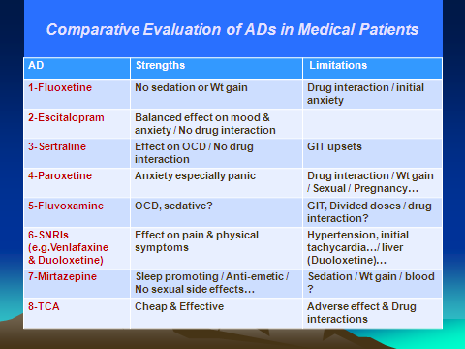

Slide 19
Theories to Explain
Depression-Medical Comorbidity

Slide 20
Theories to Explain ?
A-BIOLOGICAL :
e.g. genetic predisposition, neuro-anatomical, neuro-biochemical, …
B-PSYCHO-SOCIAL :
adjustment disorder or maladaptation syndrome…
C-IATROGENIC:
e.g.steroids, interferon, chemotherapy….

Slide 21
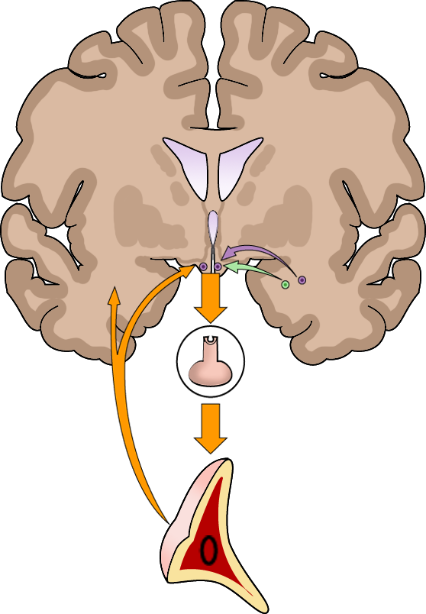
Hippocampal dysfunction & neuroendocrine dysregulation
Hippocampus
Hypothalamus
-
-
+
Hippocampus
-
Amygdala
CRF
Pituitary
ACTH
Glucocorticoids
Dexamethasone
Adrenal
cortex
Nestler EJ, et al. Neuron. 2002;34(1):13-25.
Notes:
KEY POINTS
During periods of prolonged stress, such as during depressive episodes, normal mechanisms for dealing with stress may malfunction and lead to damage of the hippocampus.
This damage can then lead to disruption of feedback loops designed to restore homeostasis, leading to a runaway system and even more neuronal damage.
REFERENCE
Nestler EJ, Barrot M, DiLeone RJ, et al. Neurobiology of depression. Neuron. 2002;34(1):13-25.

Slide 22
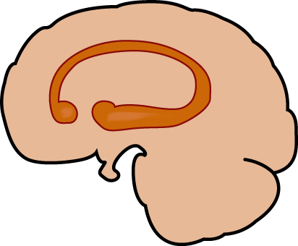
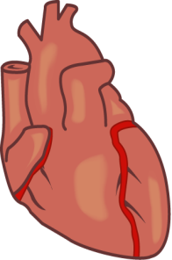
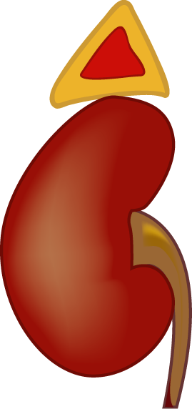
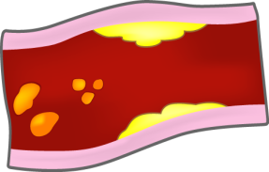
MDD as a systemic disorder !?
2. The adrenal gland releases excessive amounts of catecholamines and cortisol
3. Increase in catecholamines can lead to myocardial ischemia,
diminished heart rate variability, and can contribute to ventricular arrhythmias
ACTH
4. Increase in catecholamines causes platelet activation; increase in cytokines and interleukins may also contribute to atherosclerosis and eventual hypertension
Hypothalamus stimulates the pituitary gland to release excessive ACTH, continuously driving the
adrenal gland
5. Cortisol antagonizes insulin and contributes to dyslipidemia, type 2 diabetes, and obesity; increases in cortisol also suppress the immune system
Adapted from: Musselman DL, et al. Arch Gen Psychiatry. 1998;55(7):580-592.
Notes:
KEY POINTS
MDD may not only be a “psychiatric disease,” as there is evidence of widespread systemic consequences. Neuroendocrine dysregulation and elevated sympathetic tone may result in cardiovascular morbidity and increased risk of metabolic syndrome. Immune response may be compromised in MDD.
Major depression and depressive symptoms, although commonly encountered in medical populations, are frequently underdiagnosed and undertreated in patients with cardiovascular disease (CVD).
This is of particular importance because several studies have shown depression and its associated symptoms to be a major risk factor for both the development of CVD and death after an index myocardial infarction.
Treatment of depression in patients with CVD may be able to improve their dysphoria and other signs and symptoms of depression and improve quality of life.
BACKGROUND
“This review of the extant literature is derived from MEDLINE searches (1966-1997) using the search terms “major depression,” “psychiatry,” “cardiovascular disease,” and “pathophysiology.”
“Studies investigating pathophysiological alterations related to CVD in patients with depression are reviewed.”
“The few studies on treatment of depression in patients with CVD are also described.”
REFERENCE
Musselman DL, Evans DL, Nemeroff CB. The relationship of depression to cardiovascular
disease: epidemiology, biology, and treatment. Arch Gen Psychiatry. 1998;55(7):580-592.

Slide 23
( GENERAL PRINCIPLES & ASPECTS TO BE CONSIDERED ?? )

Slide 24
Psychopharmacology of Depression in the Medically ill (Aspects to be considered)
A)-Medical adverse effects of anti-depressants
B)-Iatrogenic depression with medical drugs
C)-ADs & Medical drugs : possible drug-drug interactions ?
D)-Choice of AD in the medicallly ill people : Precautions ?
E)-dealing with “psychiatric emergencies” in medically ill patients ( Alternate routes of drug adminstration )

Slide 25
Principles of Drug-Drug Interactions
A)- PHARMACOKINETICS : (ADME)
1-Absorption
2-Distribution
3-Metabolism
4-Excretion/ Elimination
B)- PHARMACODYNAMICS
1-Synergetic
2-Antagonistic
C)-IDIO-SYNCRATIC

Slide 26
Metabolism ?
Phase II Metabolism | Phase I Metabolism
Hepatic & gut conjugation enzymes | Hepatic & gut oxidation enzymes | definition
UGTs (uridine 5 diphosphate gluconosyltrasferases) (1A & 2B) | CYP enzymes mainly in gut & liver ( 1A2,3A4, 2D6…) | Primary systems
-Sulfotransferases -Methyltransferases | -MAO -Dehydrogenases -Hydrolysis by esterases & amidases | Secondary systems
Generally inactive ( except morphine & codeine) | May be active or inactive | Metabolites
LORAZ,OXAZEP.,TEMAZ..,LAMOTR.,.. | Most drugs | Examples

Slide 27
Psychopharmacology of Depression in the Various Medical Disorders

Slide 28
EXAMPLES
GIT disorders
Renal disorders
CVS disorders
Respiratory disorders
Oncology
CNS disorders
Endocrine & metabolic disorders
Obstetrics & Gynaecology
Infectious diseases
Skin disorders
Reumatological disorders
Surgery, organ transplantation..

Slide 29
Depression & Liver Disease

Slide 30
Case Illustration Example
A 42 year-old man has been accidentally discovered to have HCV , through routine blood test evaluation. Further investigations revealed an active hepatitis , with impaired liver function tests , which necessitated starting INF-alpha therapy.
Shortly after, he went into moderately severe depression , with lack of interest & death wishes , but the hepatologist advised not using any AD , as the liver condition was “critical” , according to his saying. The patient’s depression got worse ,to the extent of refusing treatment , with compelling suicidal thoughts , so , psychiatric consultation was requested.

Slide 31
Q1-The following is true about depression with INF therapy :
A-It affects 10-50% of cases.
B-It is the most common reason for discontinuation of INF-alpha therapy.
C-It is much less reported with INF-beta.
D-Prophylactic AD treatment may be beneficial.
E-All of the above.

Slide 32
Q2-The mechanism of INF-alpha induced depression is possibly related to :
A-activating “kynurenine pathway” , concurrent to 5HT synthesis.
B-decreasing CNS tryptophan level, by disrupting mechanism of its transport across BBB.
C-disruption of immune response mediated by a variety of cytokines.
D-associated “hypothyroidism”.
E-all of the above.

Slide 33
Psychotropics in hepatic insufficiency
CLASS | PRECAUTIONS
Anti-depressants | -SSRI : decrease dose (50%) , longer intervals, SER, ESCITAL,…. -decrease VEN. By 50% , not for DESVEN…, also, decrease BUPROB. -TCA,TRAZ, MRZ : with caution, but no dosing guidelines -AVOID : MAOIs,DULOX,NEFAZ, ..
Conventional APs | -AVOID : phenothiazines -Butyrophenones : no specific dose recommendations
AAPs | -Dose reduction : QUET,RISP -Caution, but no dose adjustment : ARZ,OLZ,ZIPRA,.. -PALIPER.: renally excreted -NOT RECOMMENDED : CLZ, ILOPER.,…
Anxiolytics | -1st Choice : metabolism by conjugation (LORA, OXAZEP,..) -AVOID : Long or intermediate acting ( DIAZ,CLONAZ,..) , RAMELTEON.. -Dose reduction : ALPRA, Z-hypnotics
Mood Stabilizers | -AVOID : CZ , VALPR,.. -Renal excretion : Li, GABAPENT.,… -Dose reduction : LAMOT,.. & No dose recommendation : OXC,TOPI,..
Cognitive enhancers | -Primarily renal excretion : MEMANT.,, -USE WITH CAUTION : GALANTAM.,> DONAP., & RIVASTIG.,…
Psychostimulants | -ATOMOXET., use with caution / MODAF.,decrease dose
Parentral drugs | -Use : short BZ , HALOP., OLZ…/ Avoid : long Bz, phenothiazines…

Slide 34
GIT Adverse Effects of Psychotropics
Class | EFFECT
Anti-depressants | -SSRIs , SNRIs : nausea , vomiting../ UPPER GIT BLEEDING with SSRIs ? -MRZ : constipation, increased appetite…, drug induced pancreatitis -TCA : constipation , colonic toxicity, pseudo-obstruction..
APs | -phenothiazines : dry mouth, constip., cholestasis.. -CLZ : salivation… / Others :less , AP induced pancreatitis ?
Sedatives | -zopiclone & Eszopiclone : bitter taste, dry mouth , nausea.. -zolpidem : nausea, dyspepsia..
Anti-cholinergic for EPS | Dry mouth , constipation,..
Mood stabilizers | LI : nausea, vomiting , diarrhea.. Cz & VAL : nausea, vomiting ,diarrhea, hepato-toxicity.. -LAMOTR., OXC : nausea , vomiting diarrhea.
Cognitive enhancers | -Nausea, vomiting , diarrhea, anorexia ( more in RIVASIG. ) -Memantine : constipation
Psychostimulant | -ATOMOXET., MODAFINIL : nausea ,dry mouth , anorexia.. -Amphetamines : stomachache , anorexia

Slide 35
Psychiatric Side Effects of GIT Drugs
Example | EFFECT
Steroids | Mania , psychosis , anxiety , depression…
H2 Antagonists | Headache , dizziness , malaize , nervousness…
Irritable Bowel Drugs | Dizziness, blurred vision , confusion & excitementin the elderly…
Proton Pump Inhibitors | (omperazole, pantoprazole,,) : dizziness
Anti-diarrheal Agents | Lethargy , sedation ,confusion…
Anti-emetics | Dizziness , ataxia , convulsions , confusion, headache , EPS, sleep disturbance..
Sulfasalazine | Headache , anorexia
Others | e.g.colchicine , salazopyrine, Interferon,…..

Slide 36
GIT Drug-Psychotropic Drug Interactions
GIT drug | Mechanism | Effect on psychotropic
Antacids | Increased gastric ph, delayed gastric emptying | -decreased drug absorption -na bicab., may increase renal excretion of lithium
Cimetidine | Inhibits 1A2,3A4, 2D6.. | Decrease psychotropic dose
Anti-darrheal agents | Drug binding | May reduce absorption ( make a gap of 2-3 hours)
Anti- spasmodics | Additive anti-cholinergic effect | Increased risk of delirium
Anti-emetics | Qt PROLONGATION & Da antagonism | INCREASED RISK OFARRHYTHMIA & EPS
Steroids | Induce 3A4 | Decreased level of psychotropics
Nabilone | Additive sympatho-mimetic effect | Tachy-cardia & cardiotoxicity
Tegaserod | Inhibits 1A2 & 2D6 | Increased drug level

Slide 37
Depression in relation to
Diabetes Mellitus

Slide 38
Depression in relation to Diabetes Mellitus
Prevalence of depression in diabetics -15-30%
Types of depression :
-MDD, Dysthymic,Mixed Anxiety depression...
Possible aetiology :
1-biological : role of glucose in the brain?
relation to Alzheimer Dis.
2-Psychological or psycho-social ?

Slide 39
Depression in relation to Diabetes Mellitus
Effect of Depression on Diabetic course :
1-Diabetic control ?
2-Diabetic complications ?
3-Increased vascular risk & Dementia ?
4-Increased sexual dysfunction?
5-More impairment in QoL

Slide 40
Depression in relation to Diabetes Mellitus
Anti-diabetic drugs & depression :
-Possible anti-depressant effect ? (APA, may 2011)
Anti-depressants & diabetes mellitus :
-Change in glycemic control ?
-Treatment adherence, with CBT?
-Role in diabetic neuropathy : Duloxetine & SNRIs.

Slide 41
The “3-D Co-morbidity”
DEP DIABETES
DEMENTIA

Slide 42
CASE ILLUSTRATIONS

Slide 43
CASE (1)
A 42 year old surgeon, who was described by his wife as “successful and beloved”, has recently consulted his friend, who works as an internist, for generalized feeling of fatigue.
Despite all routine investigations were normal, the complaint was so severe to the extent that he decided to give up working telling that “ I have enough money to live and I think business will be more suitable and relaxing than surgery”.

Slide 44
CASE (1)
1- How would you explain the patient’s symptoms?
2- What is your suggested management plan?
3- What are the possible difficulties that might be encountered in management of such a case?

Slide 45
CASE (2)
A 56 year old man had been brought by his son to the general practitioner, because of a 3 months history of easy forgetfulness, neglect of self hygiene, retardation and lack of concentration.
For the last week, he became nearly stuperous, sleeping most of the time, hardly answering questions and mostly telling “I do not know- I cannot remember anything”.

Slide 46
CASE (2)
The physician’s diagnosis was a case of starting “dementia” and he went through investigations to prove the diagnosis, but no remarkable abnormality had been found.
According to his son, he had suffered similar symptoms 10 years ago, following the death of his wife, but they improved spontaneously within few months.

Slide 47
CASE (2)
1-What is your comment on the G.P. diagnosis?
2-Whatis your possible diagnosis? Give reasons
3-How would you manage such a condition?

Slide 48
CASE (3)
A 55 years old women comes to a psychiatrist C/O depressed mood over the last 3 months with lack of energy, and weight gain, despite her appetite has not increased.
She had never visited a psychiatrist before, but had a F.H. of bipolar disorder in her maternal uncle.

Slide 49
CASE (3)
Her medical history is irrelevant. According to the patient, when she looks at the mirror she feels her self changed “My eyes are puffy, my neck is large and my face became dull and ugly.

Slide 50
CASE (3)
1-What is your most likely D.D.?
2-What further steps you need in assessment of such a condition?
3-Give your plan of management?

Slide 51
CASE (4)
A 31 year-old woman had been under treatment from depression for two years, maintained on AD medication. After discovering that she is pregnant, she consulted her gynaecologist who advised her to stop psychotropic medication immediately otherwise ‘’ he will not be responsible for what will happen to the baby ‘’. One month later, she became severely depressed & suicidal.

Slide 52
CASE (4)
Consulting her gynaecologist again, he insisted not to take any psychotropics “These drugs are for ‘mad’ people, and you are not mad”. One week later, she threw herself from secod floor,which resulted in abortion & multiple fractures.
Q-1-Comment on Gynaecologist’s attitude.
Q-2-Comment on AD use in pregnancy.
Q-3-Comment on ‘Medico-legal’ issues in such a case.

Slide 53
CASE (5)
A 9 year old student presents with a two-months history of school refusal without an obvious reason. Each day, he weeps & cries telling that ‘ he will die if he went to school ’. He started also to have nightmares , and his appetite became a little , with twice a history of NE.
PH was irrelevant & FH revealed Mood Disorder in his mother & paternal uncle.

Slide 54
CASE (5)
Q-1 :What is your possible diagnosis?
Q-2 :Give DD of ‘School refusal’.
Q-3 :Give a comment about presentations of depression in childhood.
Q-4 :What is your management plan ?

Slide 55
THANK YOU

