Slide 1
Sleep Medicine in Egypt :
Current & Future Perspectives
Dr.Tarek Asaad
Prof. of Psychiatry, Ain Shams University
Director of Psychophysiology & Sleep Unit
Chief Editor : Current Psychiatry ME Journal
Director of Cross Cultural Psychiatry Center

Slide 2
HISTORY OF SLEEP MEDICINE
Berger (1929).
Loomis & Harvey (1937).
Kleitman & Aserinsky (1953).
Dement & Kleitman (1957).
Stanford Narcolepsy center (1964).
Manual for scoring of sleep (1968).
PSG (1975).
ASDA (1977).
ICSD -1 (1991).
ICSD -2 (2005).
ICSD-3 (Updated 2014).

Slide 3
UPDATES IN ASSESSMENT OF SLEEP
PSG.
MSLT, MWT,…
Microstructure sleep analysis, CAP, A/D,..
Actigraphy.
Genetic studies: Narcolepsy?
Brain imaging.
Psychometric tools.
Others.

Slide 4
Classification of sleep disorders :
DSM-IV : phenomenological ?
ICD-10 : phenomenological/ aetiological
ICSD-1
ICSD-1-Revised
ICSD-II
ICSD-II-Revised
ICSD-3 -phenomenological / aetiological / research / statistical ……

Slide 5
ICSD – II ( 2005 )
INSOMNIA.
SRBD.
HYPERSOMNIAS OF CENTRAL ORIGIN.
CR SLEEP DISORDERS.
PARASOMNIAS ( NREM,REM,Others ).
SR MOVEMENT DISORDERS.
ISOLATED,N.VARIANTS,UNRESOLVED…
OTHERS
APPENDIX : Associated / Psychiatric….

Slide 6
ICSD-3 (Updated,2014)
SIX CATEGORIES OF SLEEP DISORDERS :
1-Insomnia.
2-Sleep related Breathing Disorders.
3-Central Disorder Hypersomnolence.
4-CR Sleep Wake Disorders.
5-Parasomnia.
6-Sleep related Movement Disorders.

Slide 7
WHAT IS POLYSOMNOGRAPHY?
HYPNOGRAM (E.E.G.,E.O.G.,chin EMG).
RESPIRATORY EVENTS: airflow,chest ……… and abdominal effort, O2 saturation.
LEG MOVEMENTS.
OTHERS : E.C.G., body position,snoring ………..detector,tumescence detector, ………..capnograph…etc.

Slide 8
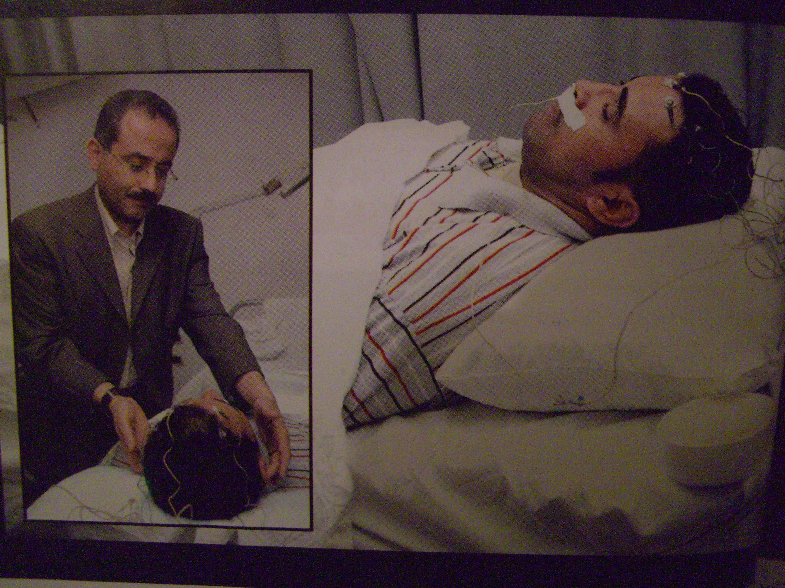

Slide 9
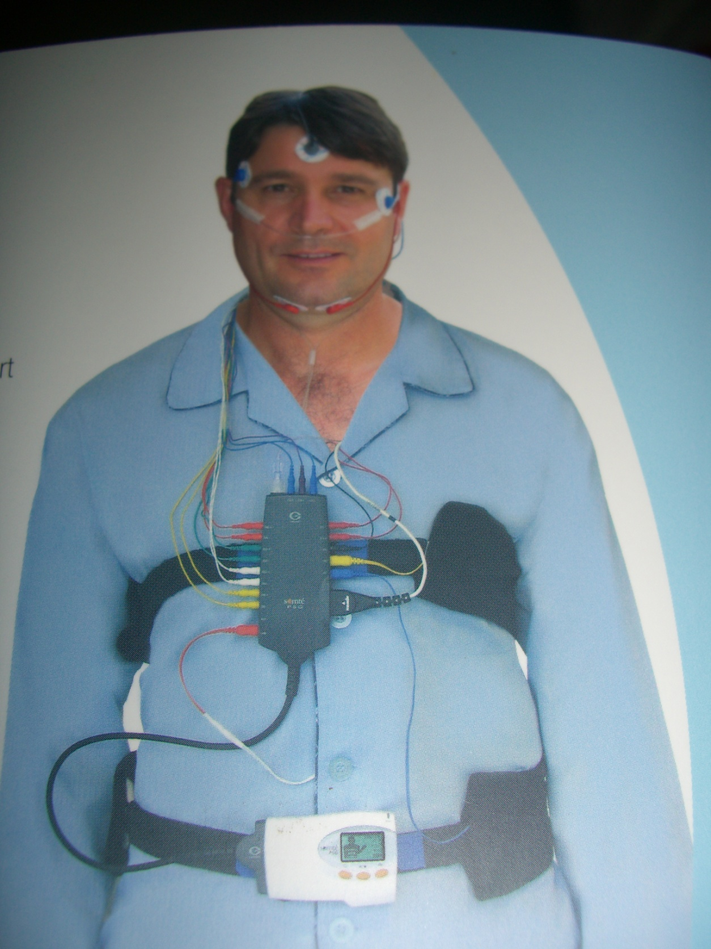
Portable PSG
Easy
More acclimatization
Allow subjects to move
Recorded on a memory card
Sleep atmosphere = “natural”

Slide 10
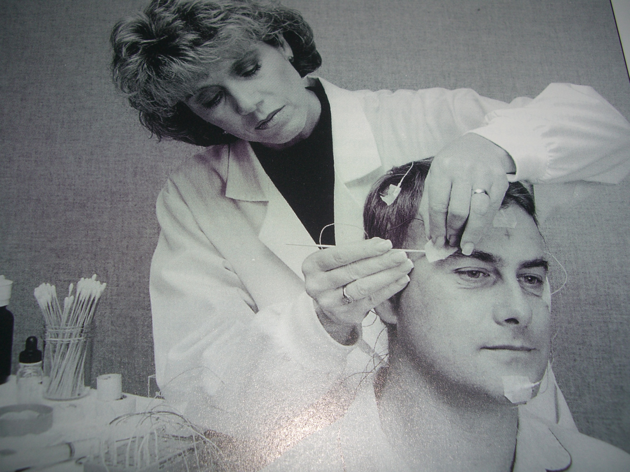

Slide 11
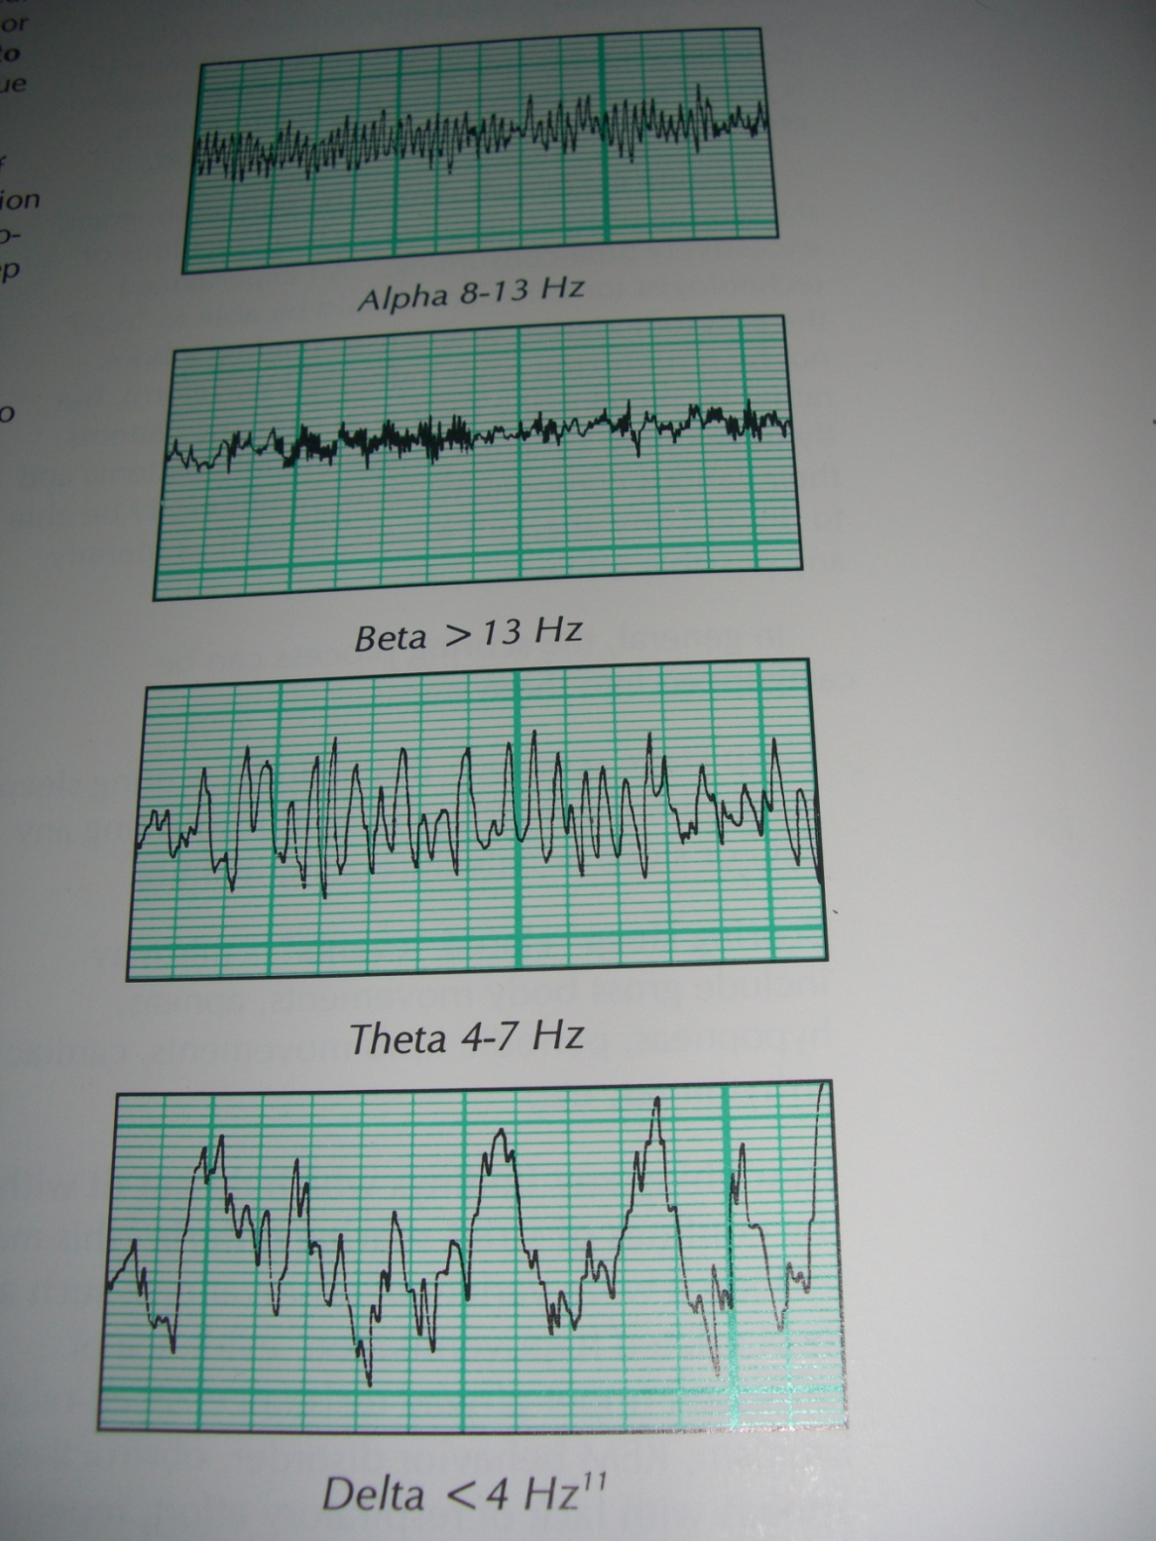
EEG waves
A

Slide 12
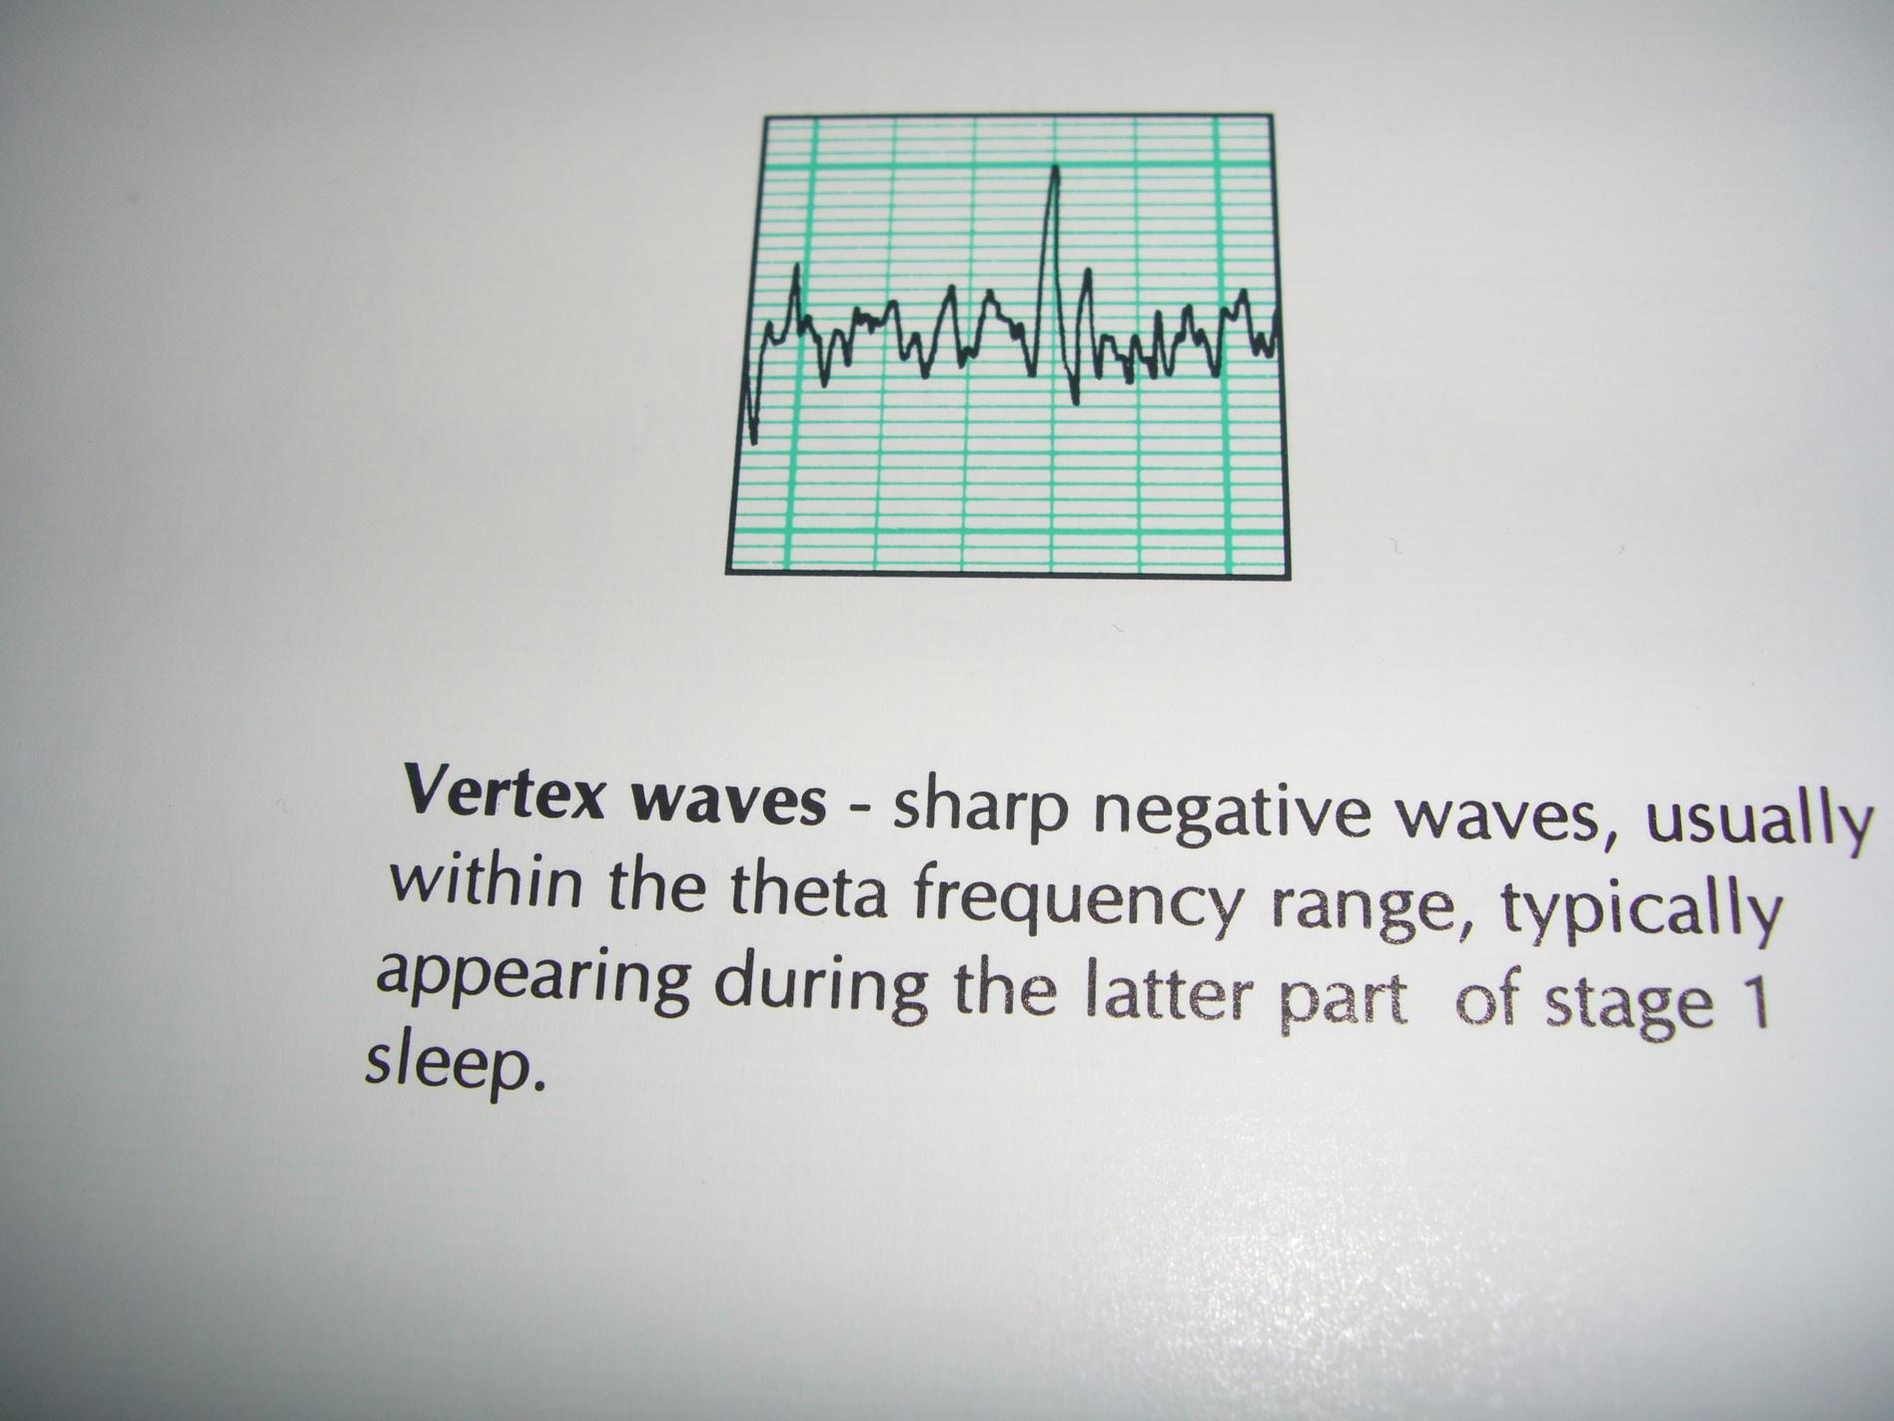

Slide 13
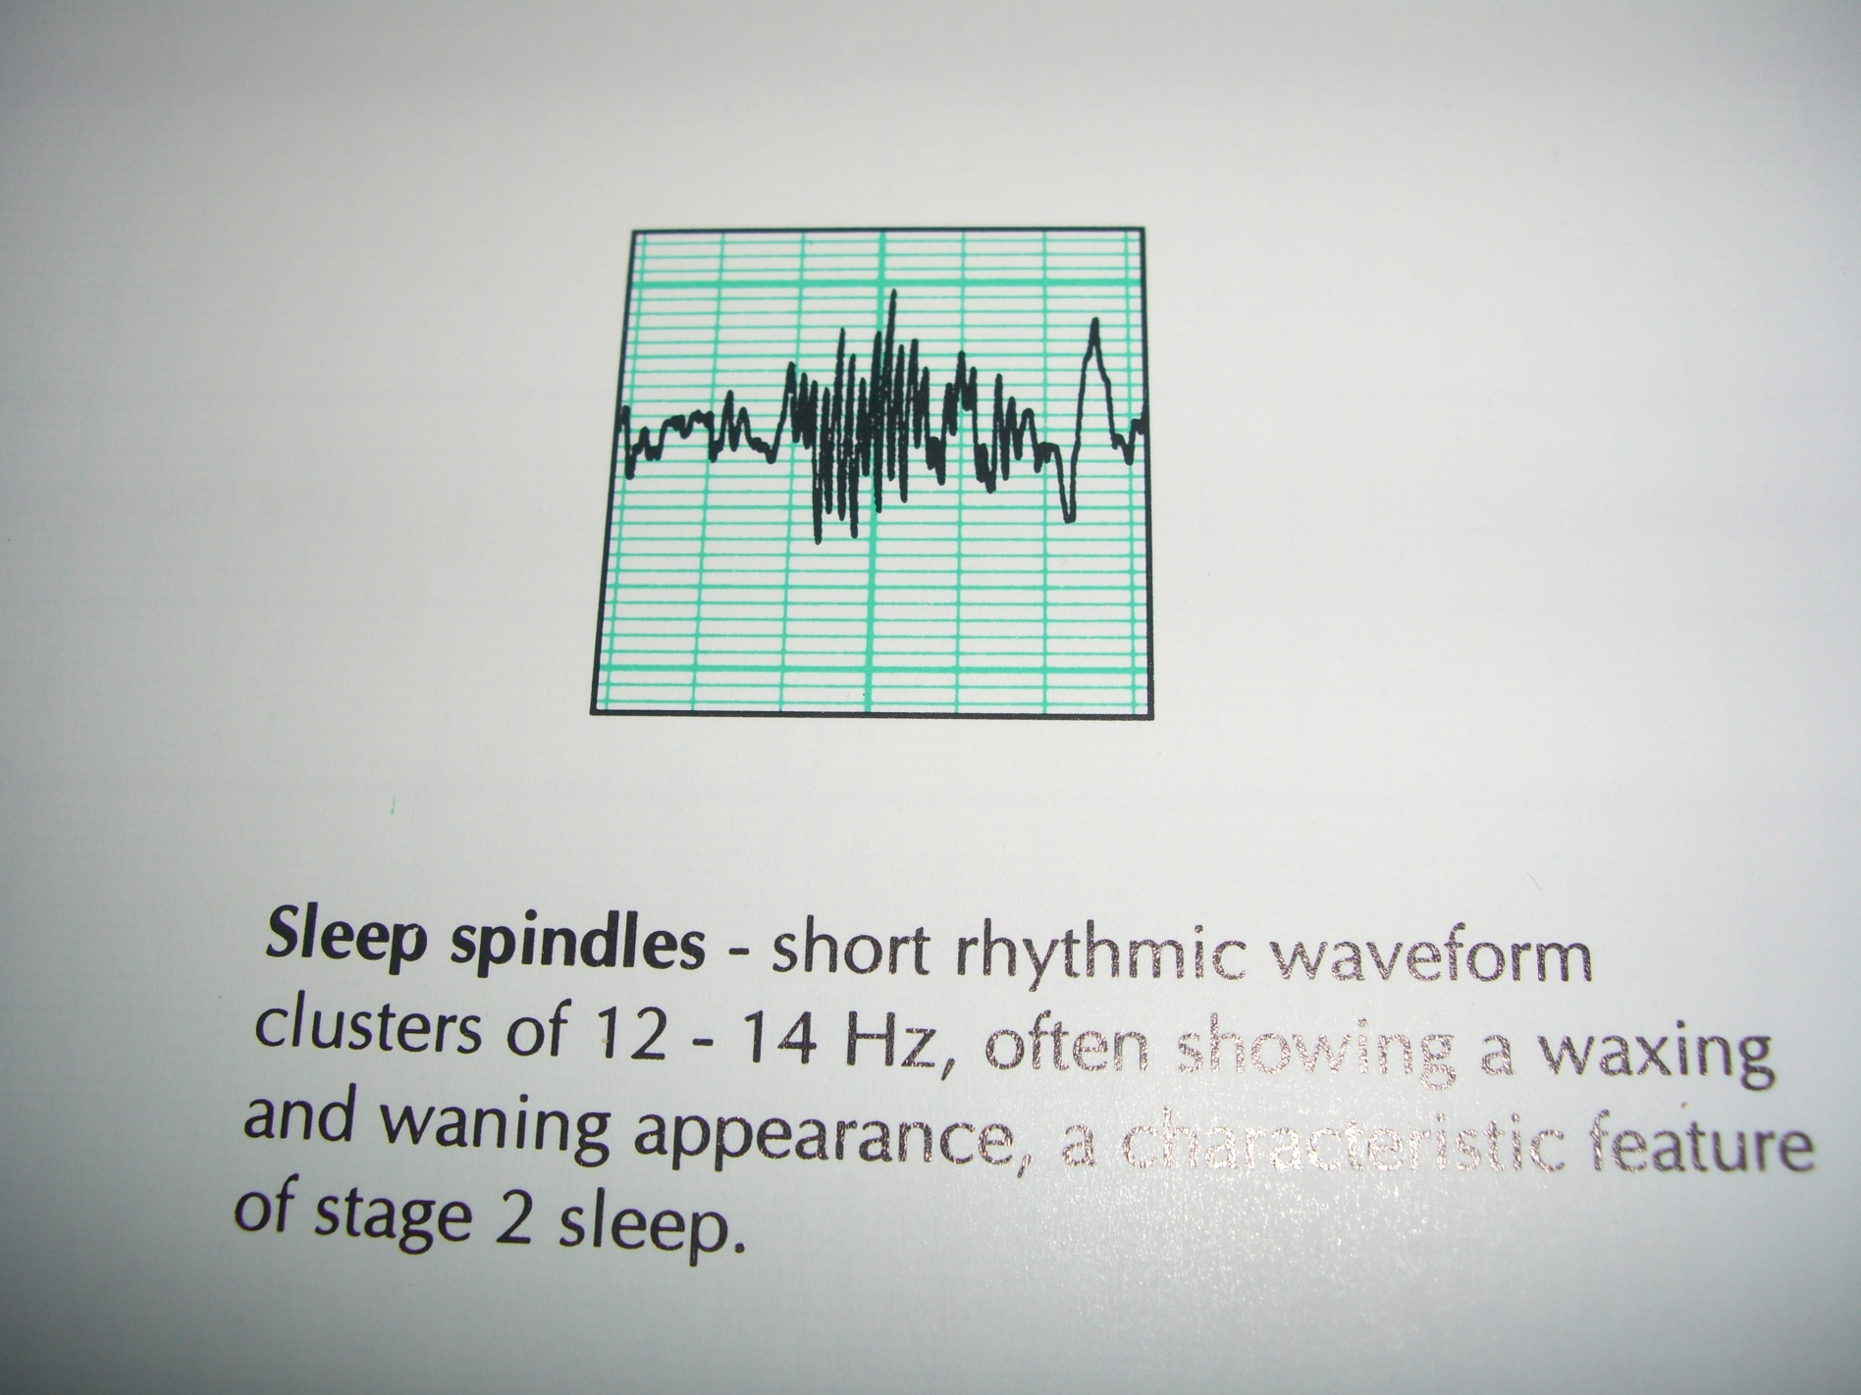

Slide 14
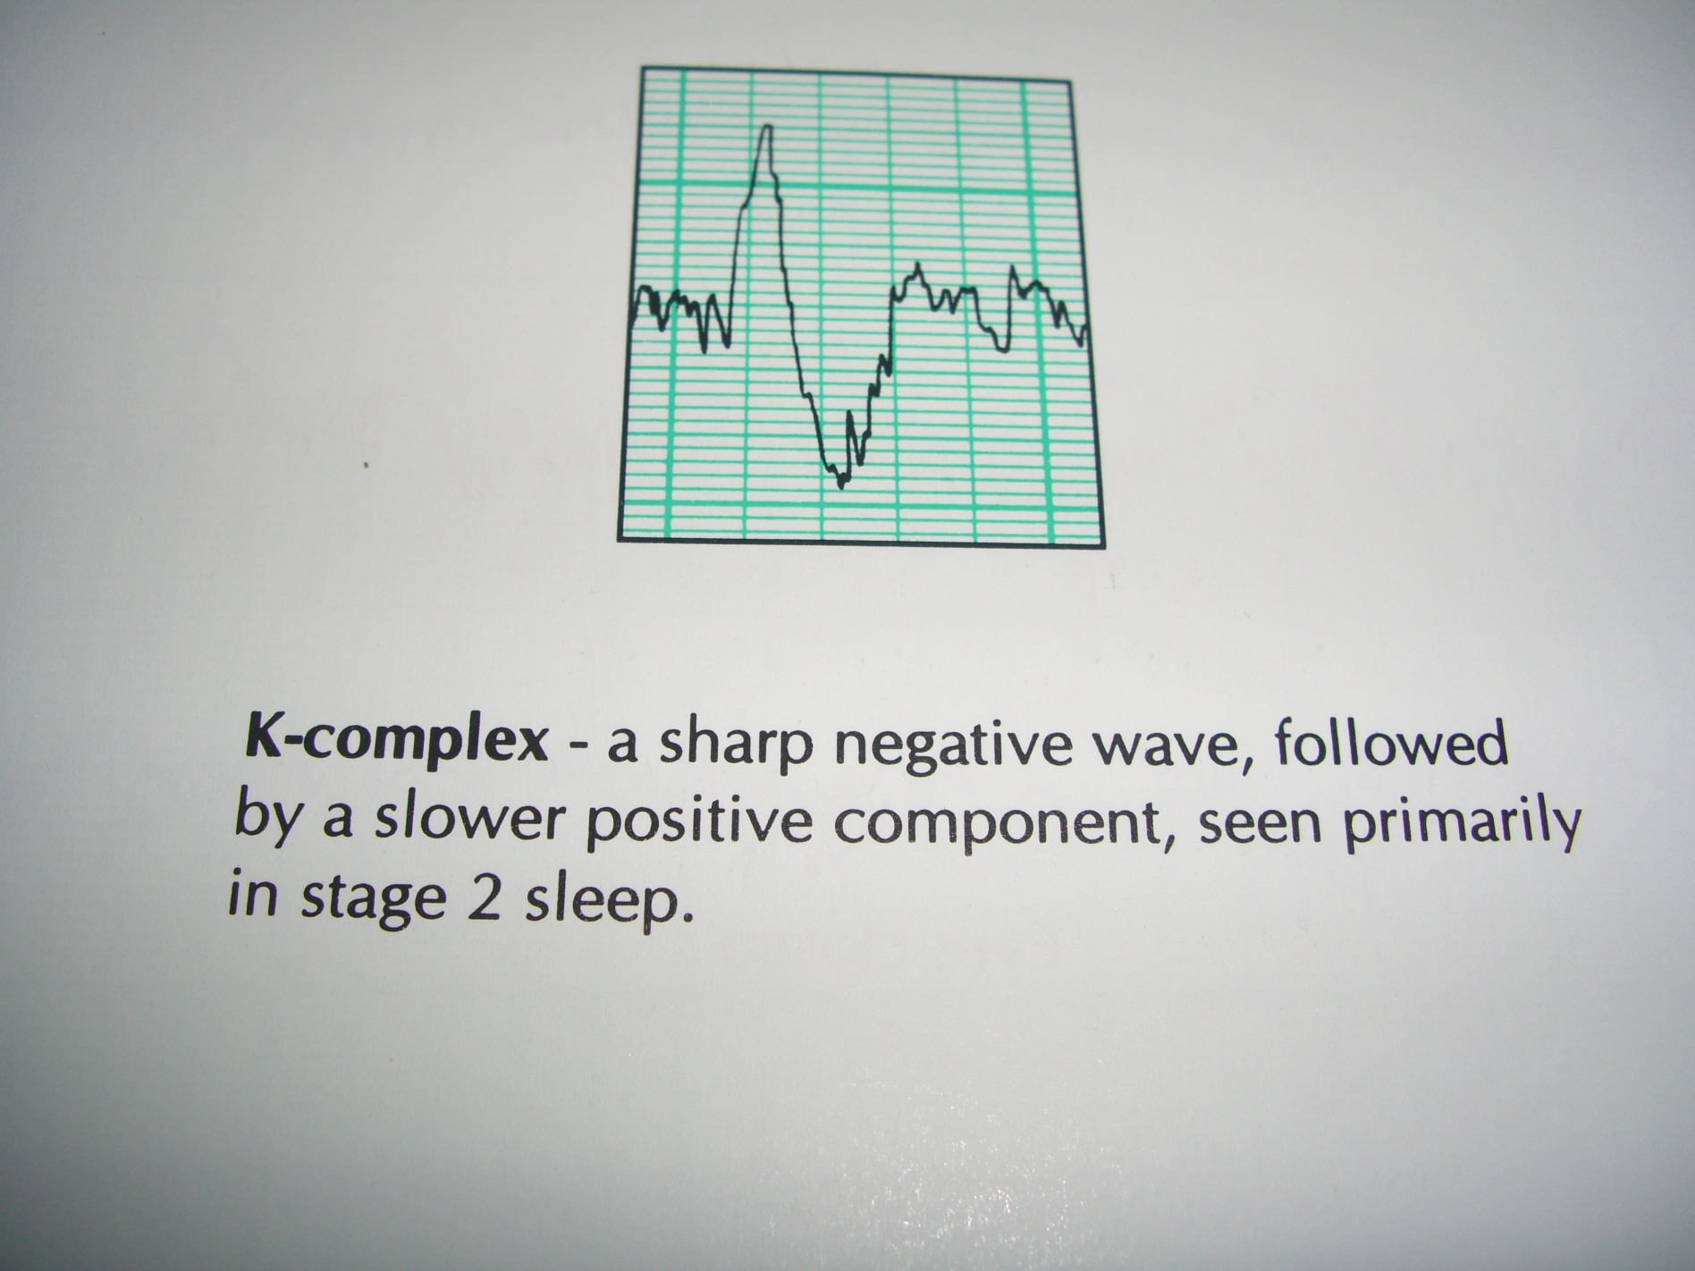

Slide 15
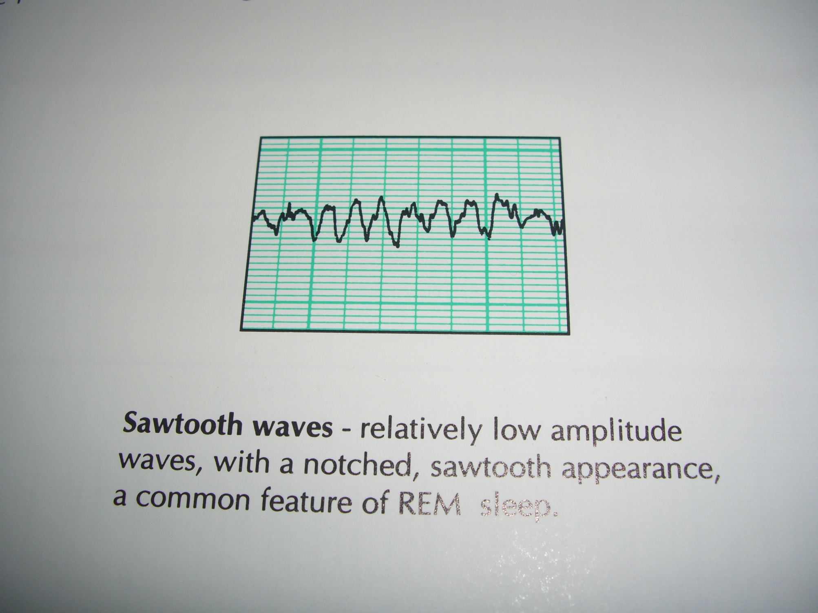

Slide 16
P.S.G. VOCABULARY
SLEEP CONTINUITY: TST , SL, SE, ………………arousal index, awakenings…
SLEEP ARCHITECTURE :stage I,II,III and IV, SWS %.
REM PARAMETERS: ……………....REM%,REML,REMD, …………...1st.REM duration and density.
RESPIRATION: apnea index,RDI,O2 ……………….desaturation.…
PLMS Index.
OTHERS.

Slide 17
PSG in different conditions
Different stages of sleep
Sleep apnea : Obstructive / Central
Periodic limb movements

Slide 18
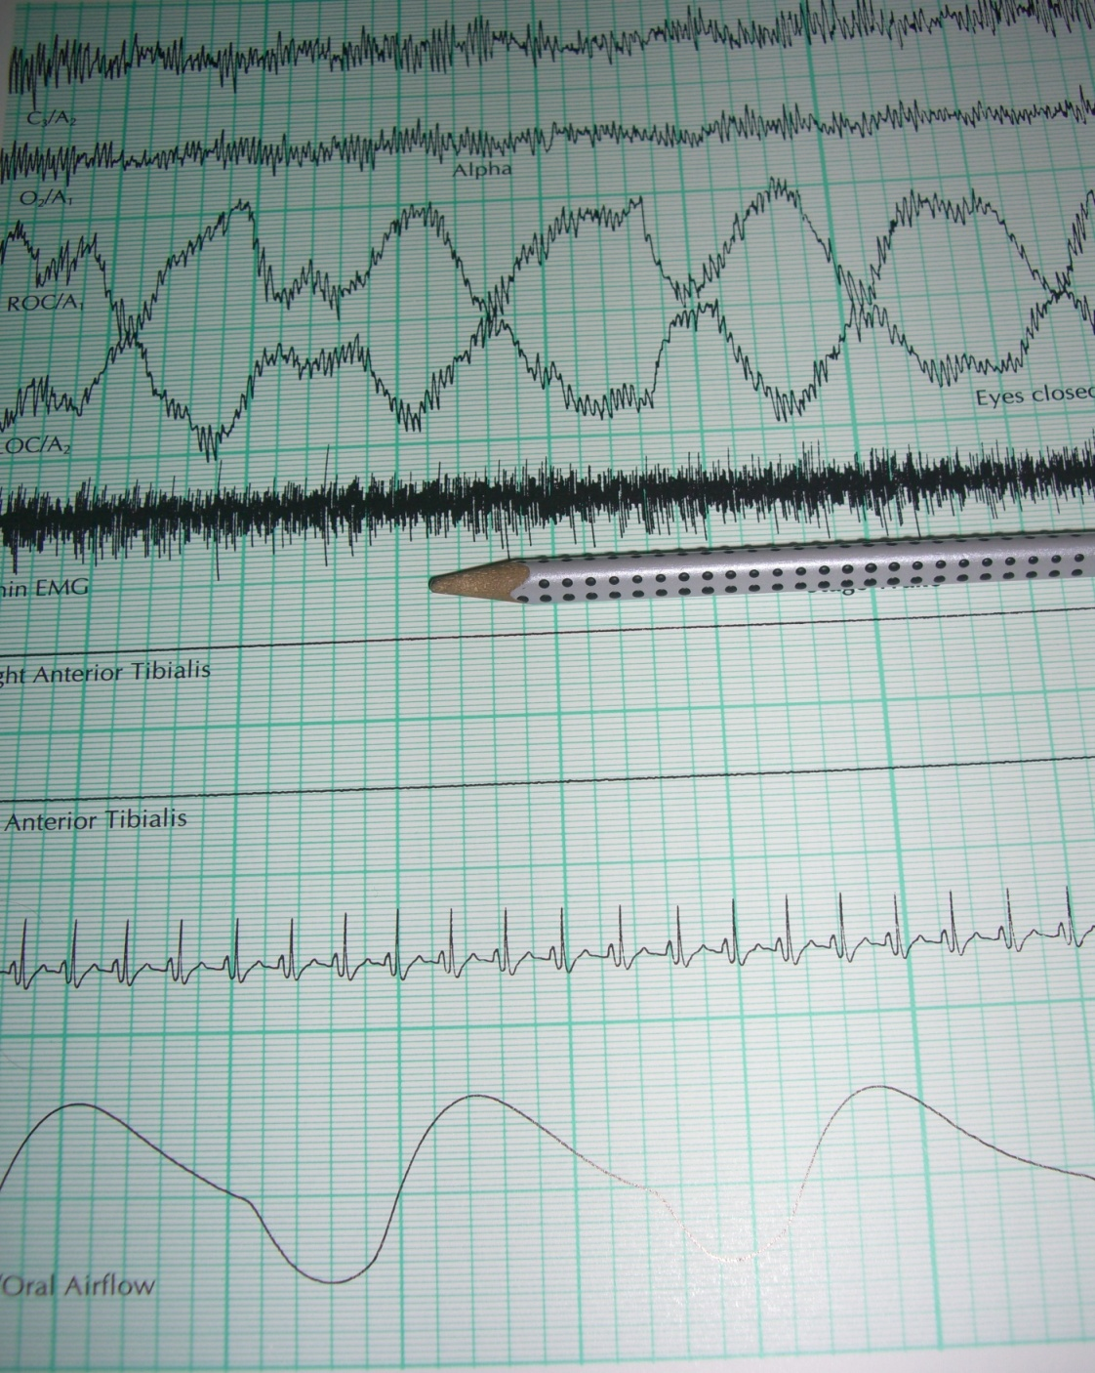

Slide 19
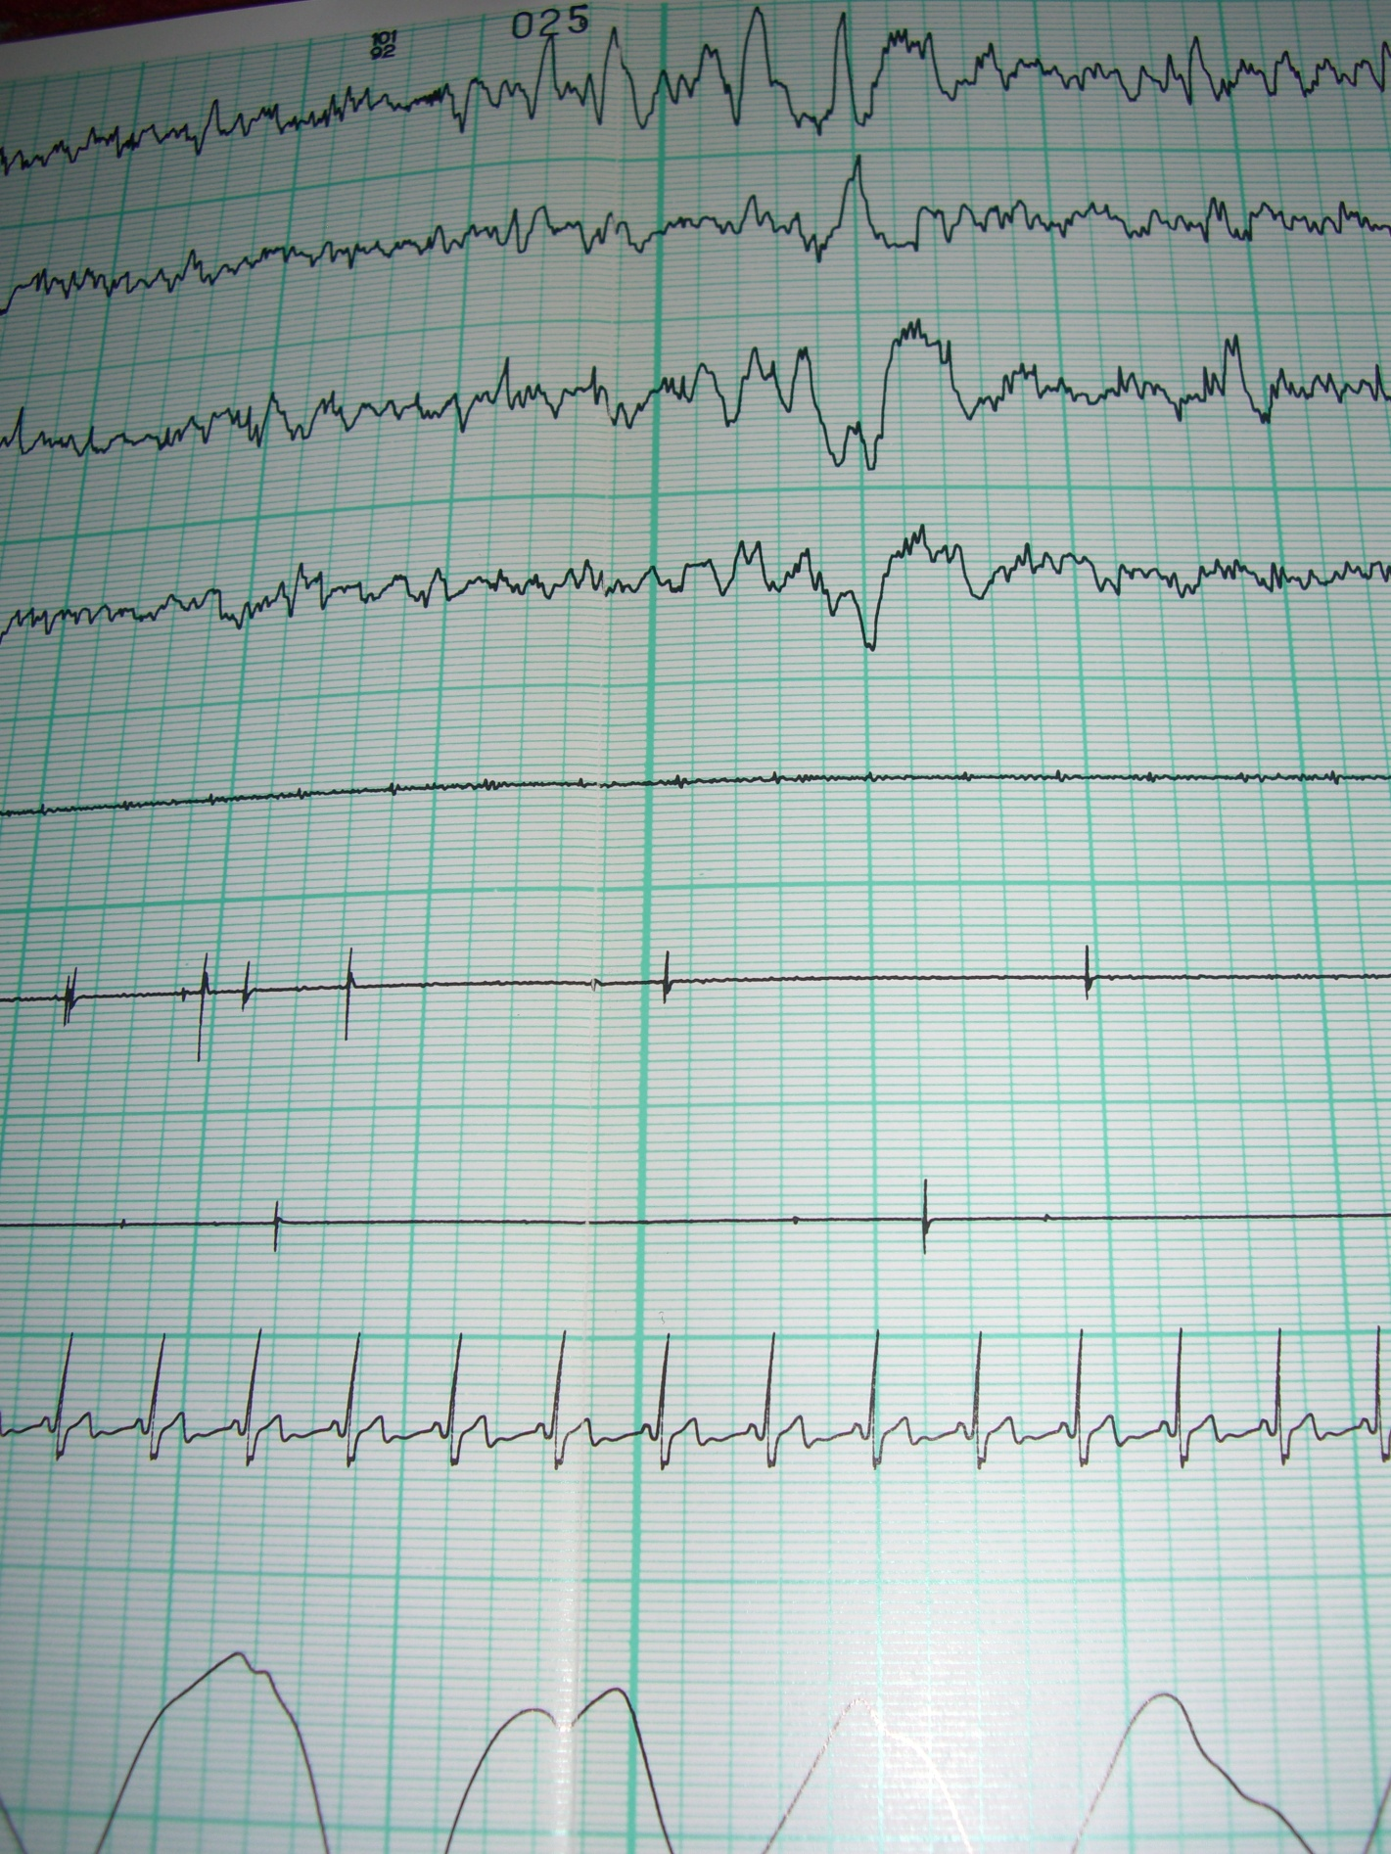

Slide 20
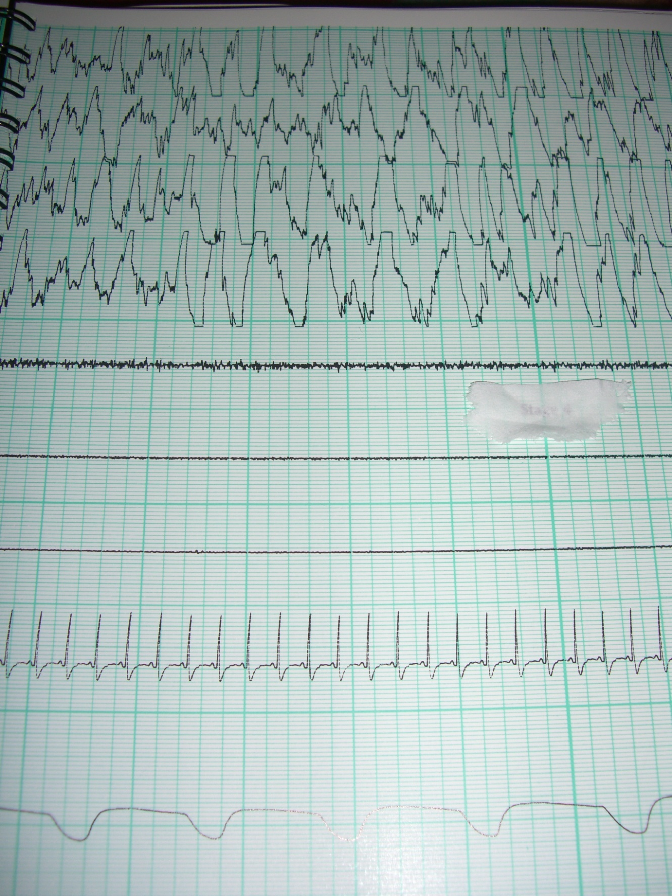

Slide 21
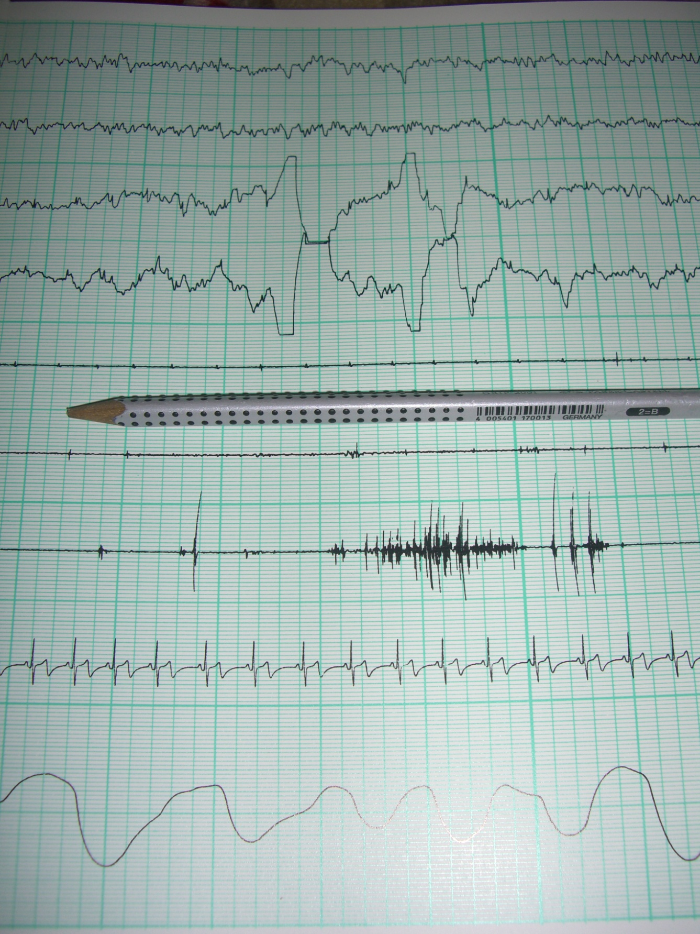

Slide 22
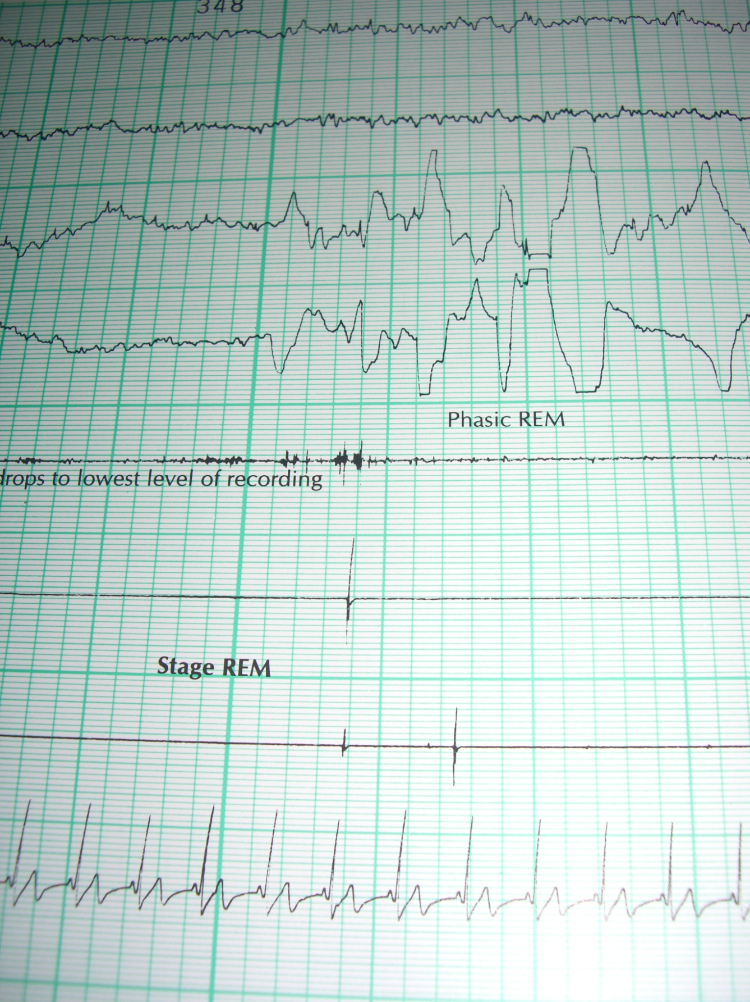

Slide 23
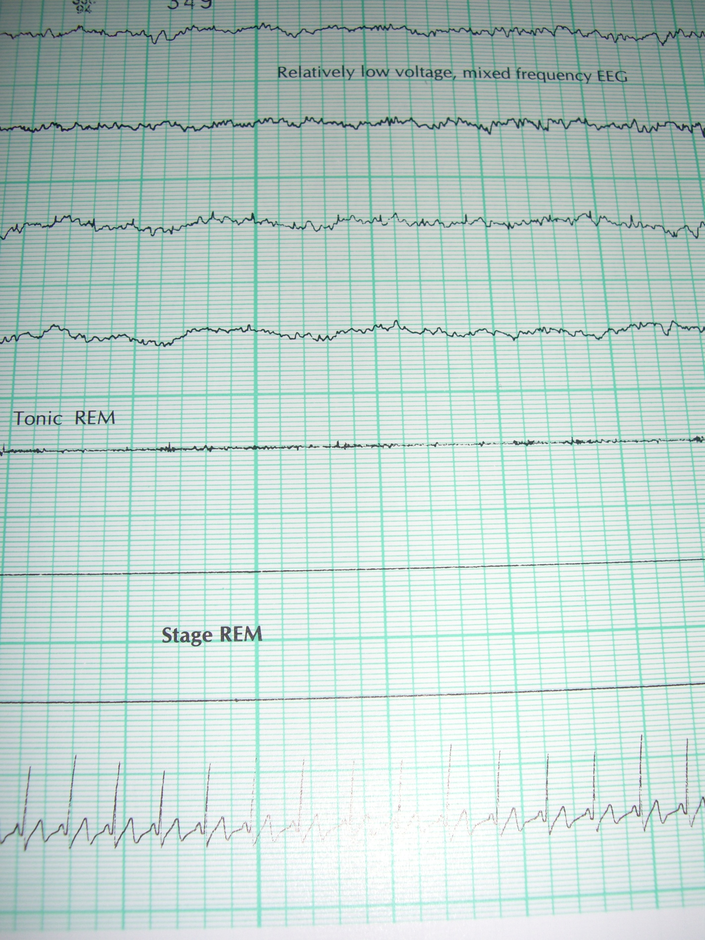

Slide 24
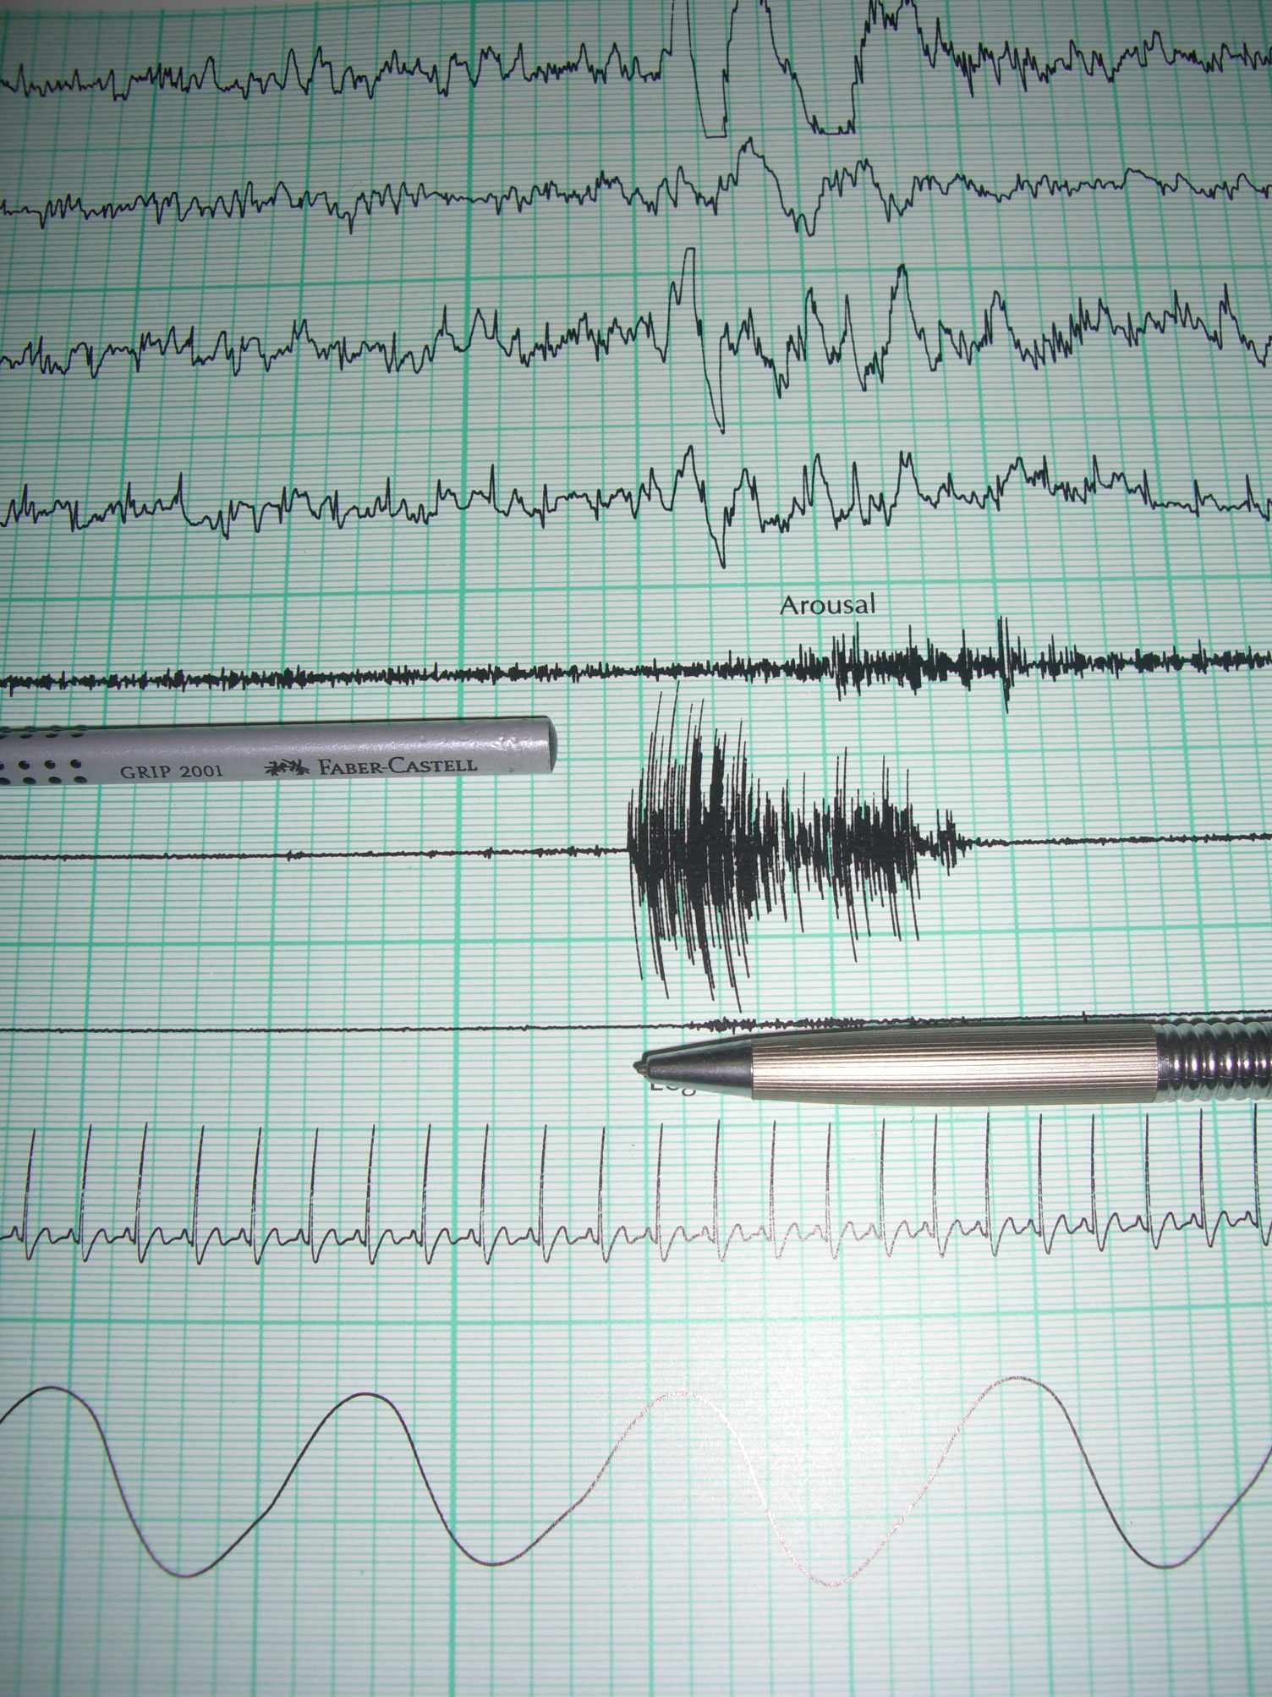

Slide 25
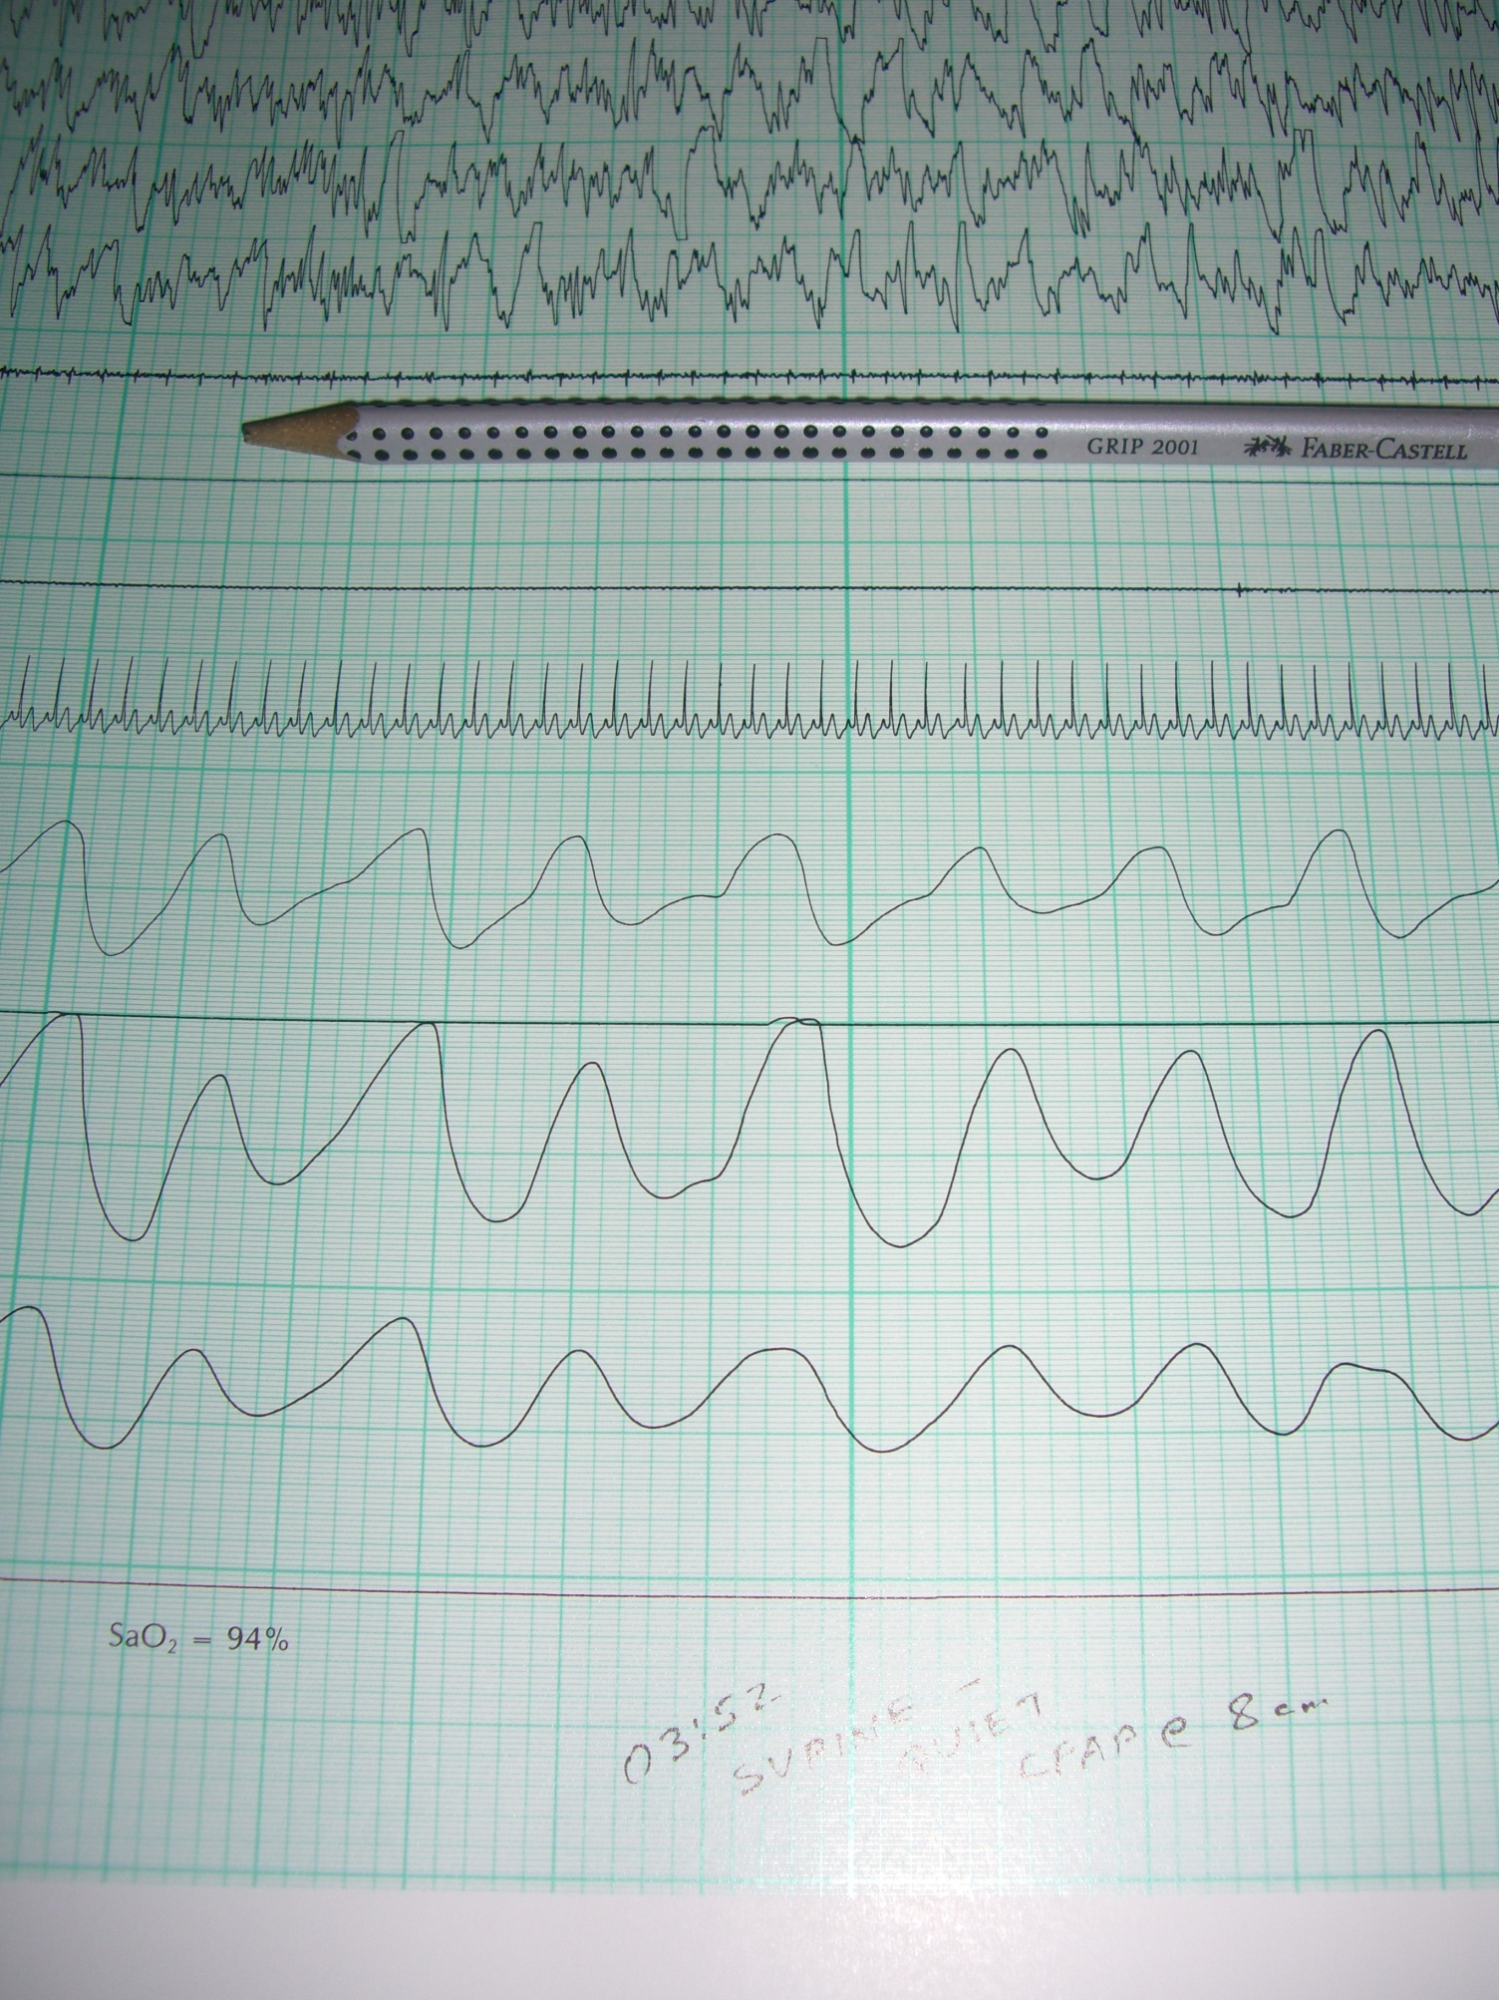

Slide 26
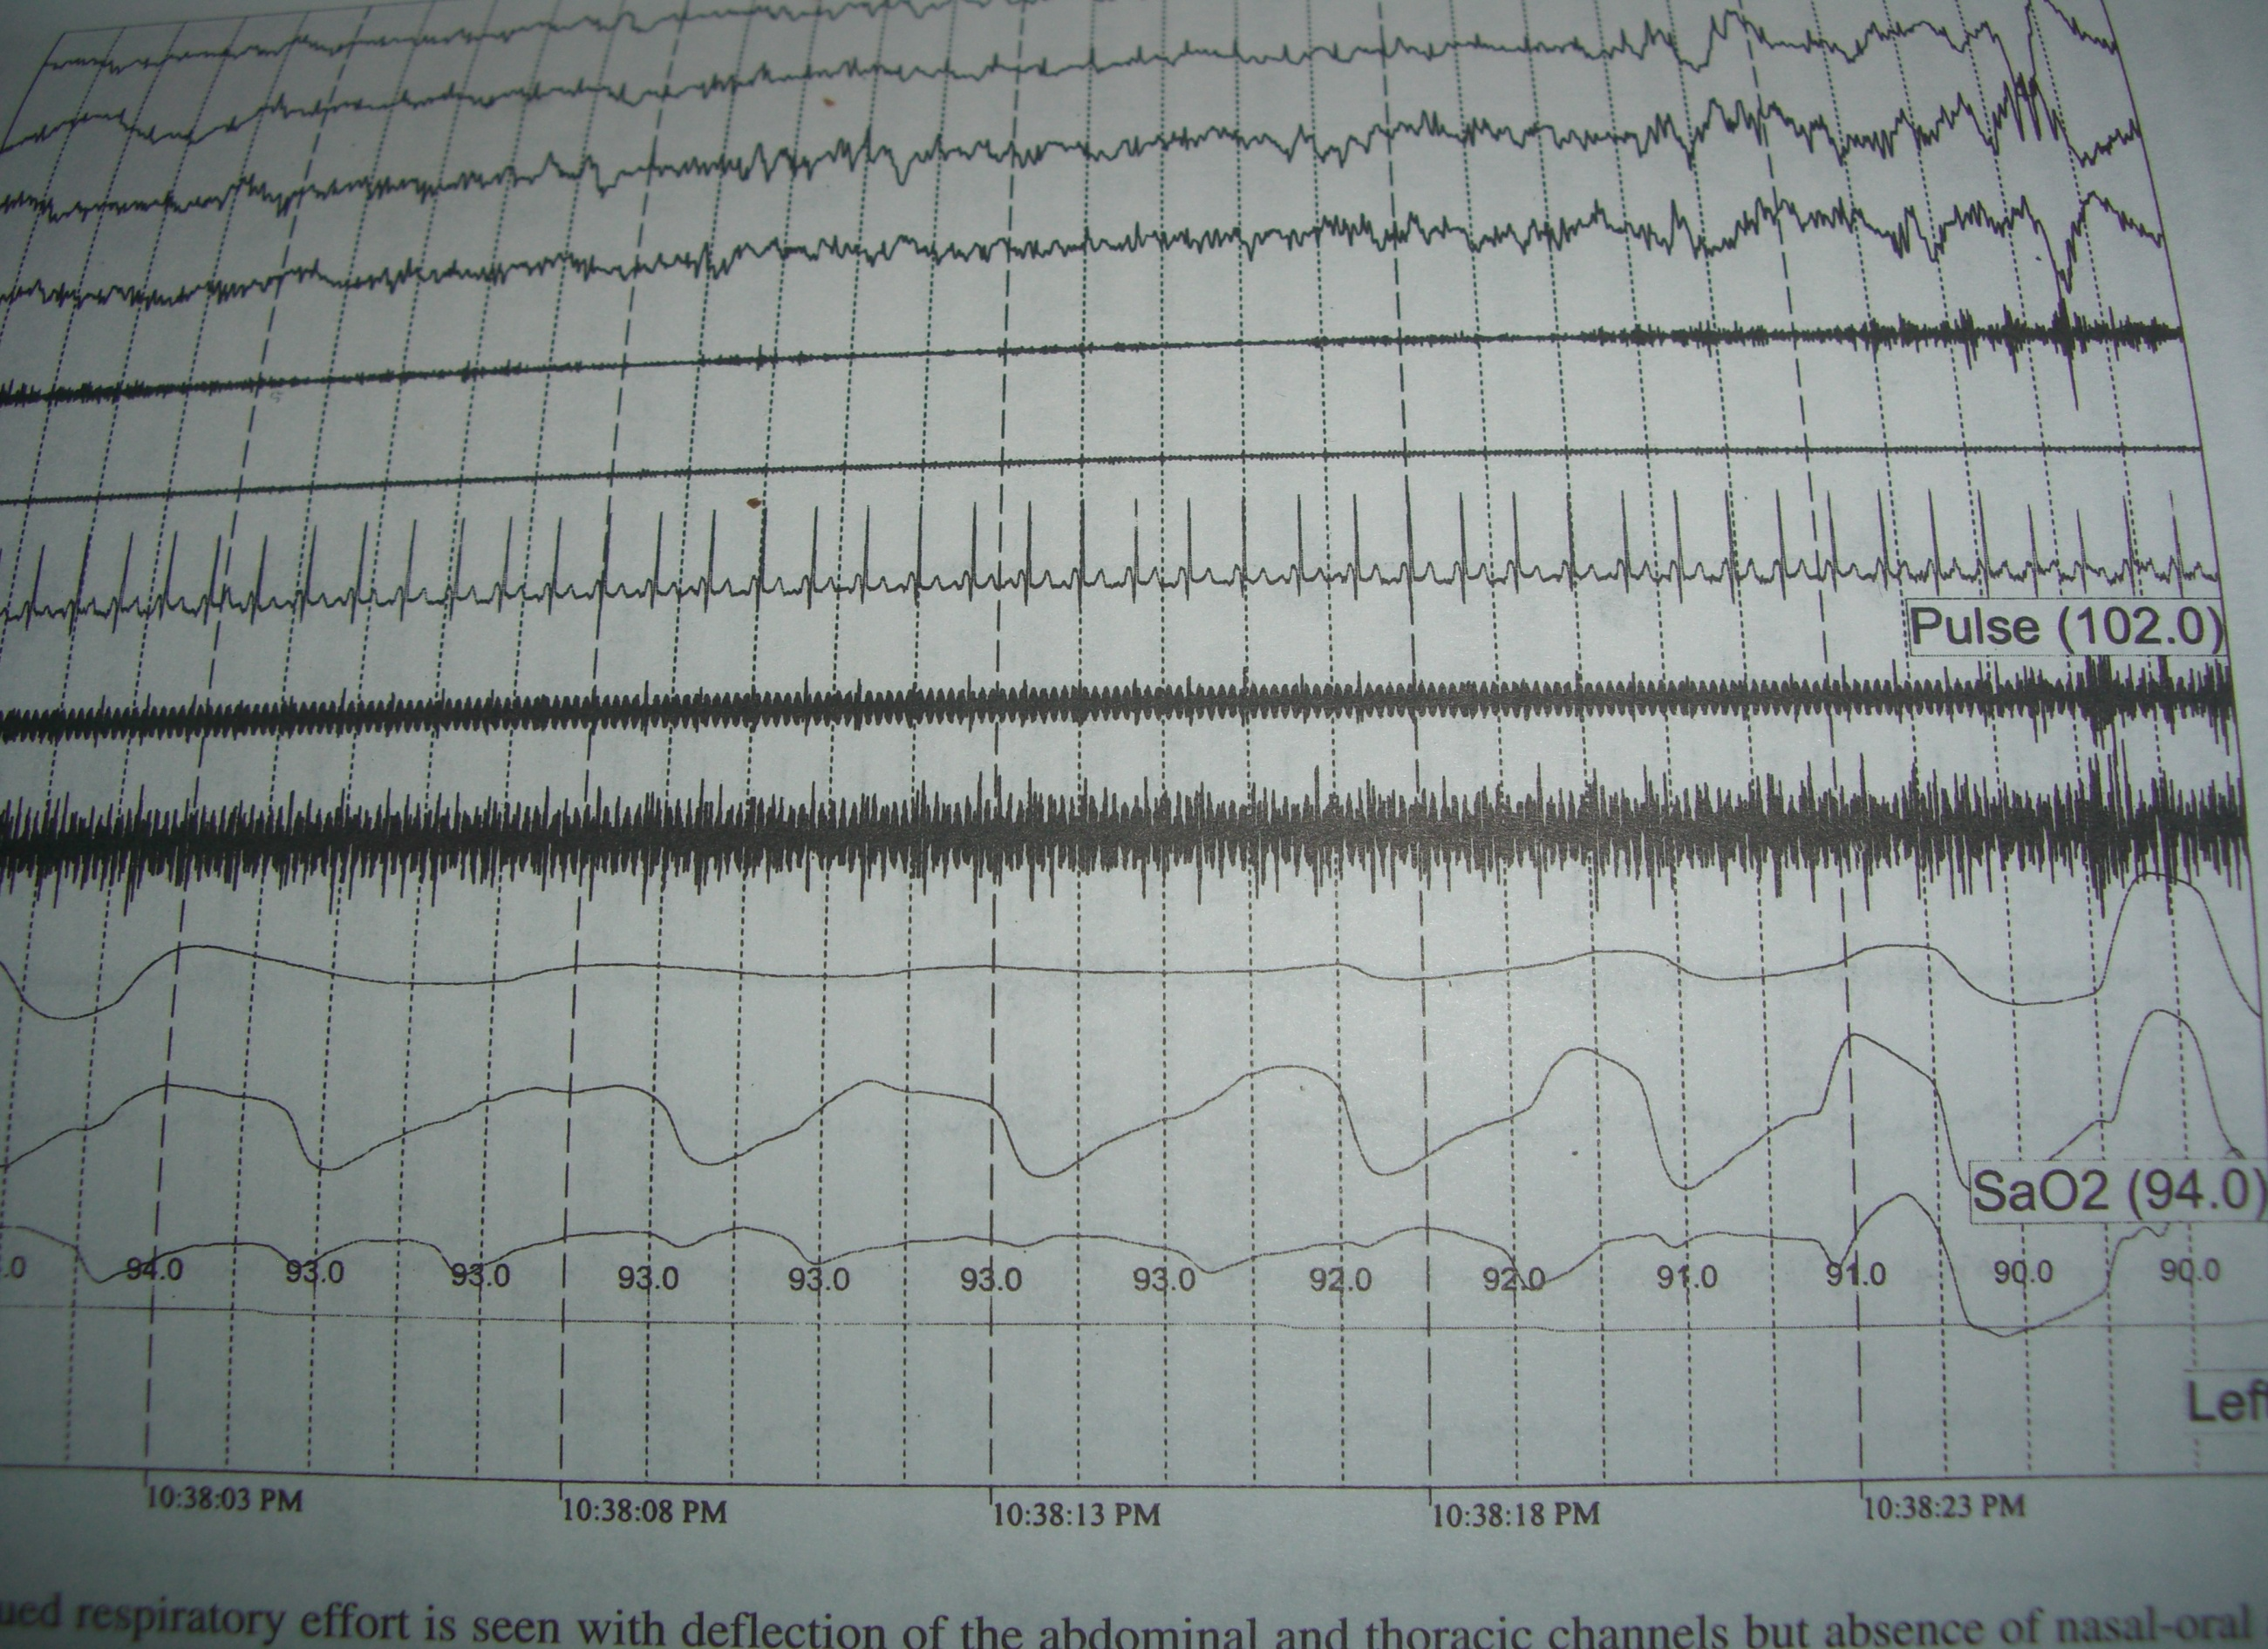

Slide 27
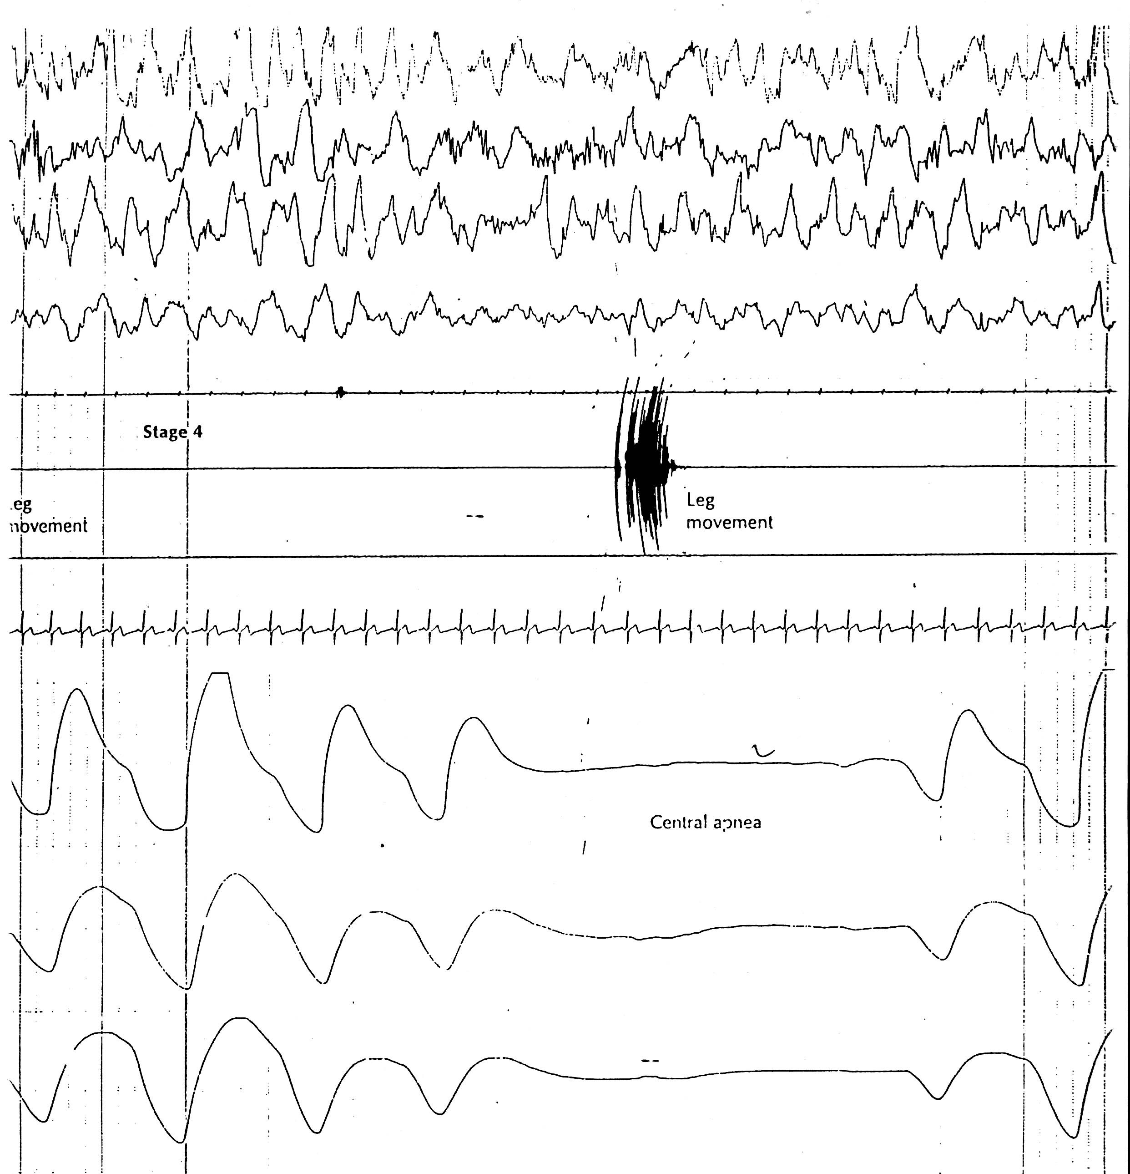

Slide 28
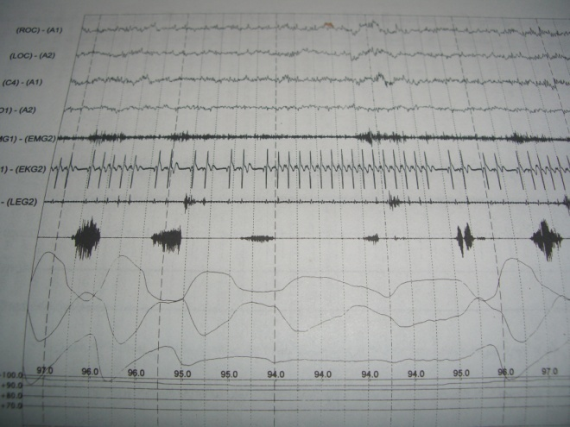
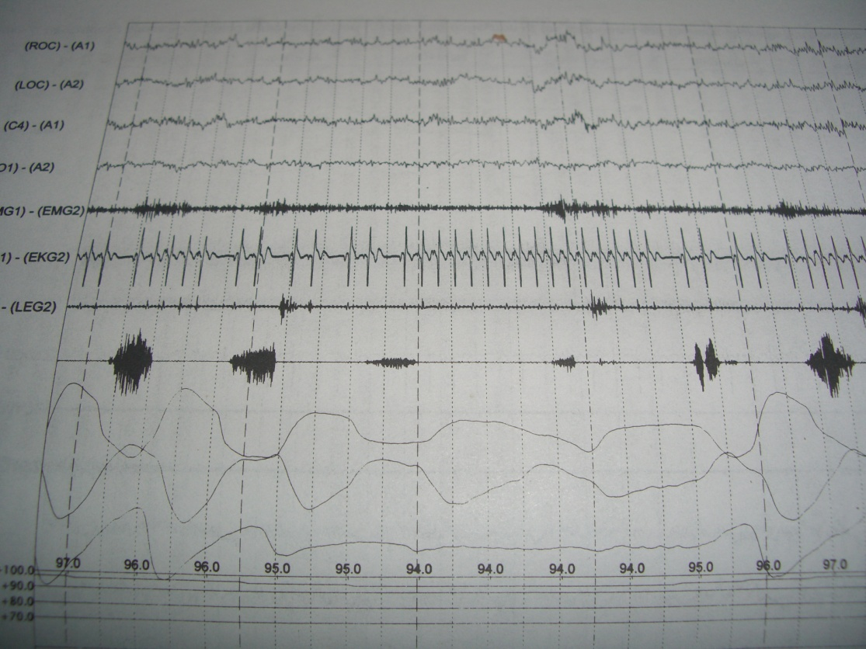
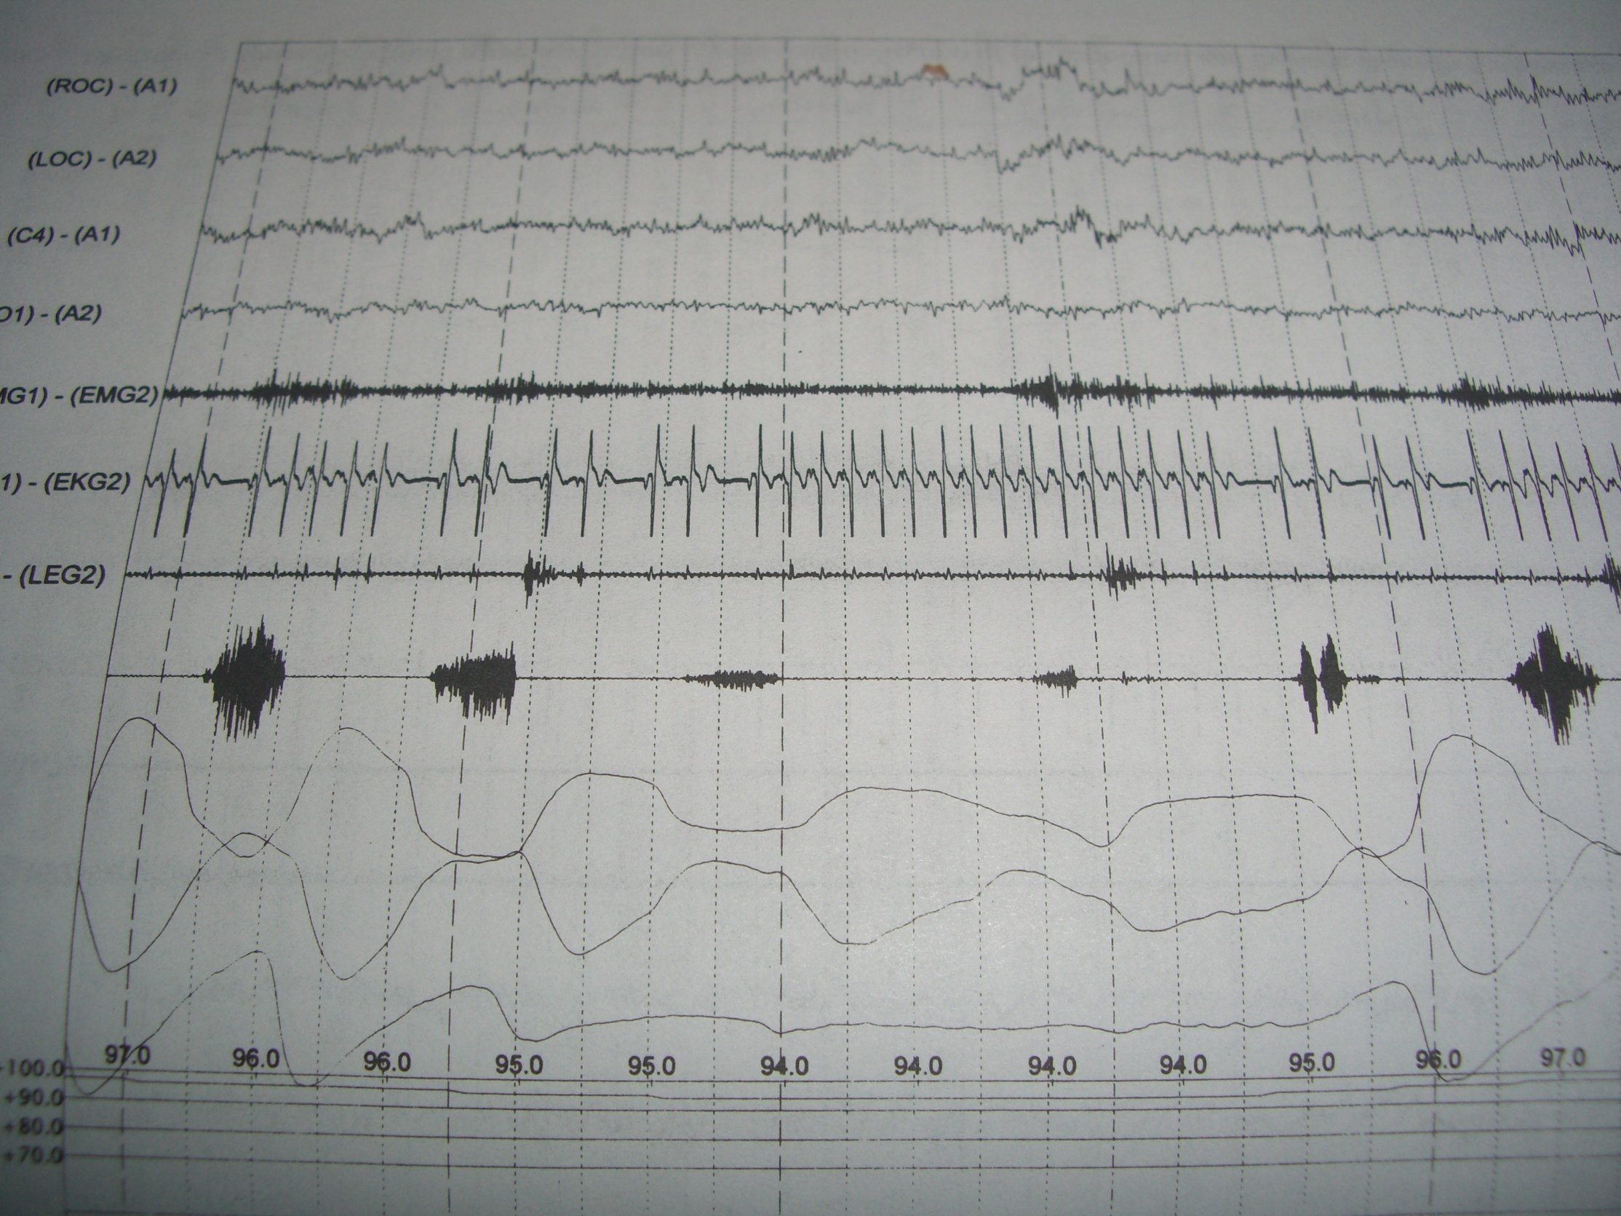

Slide 29
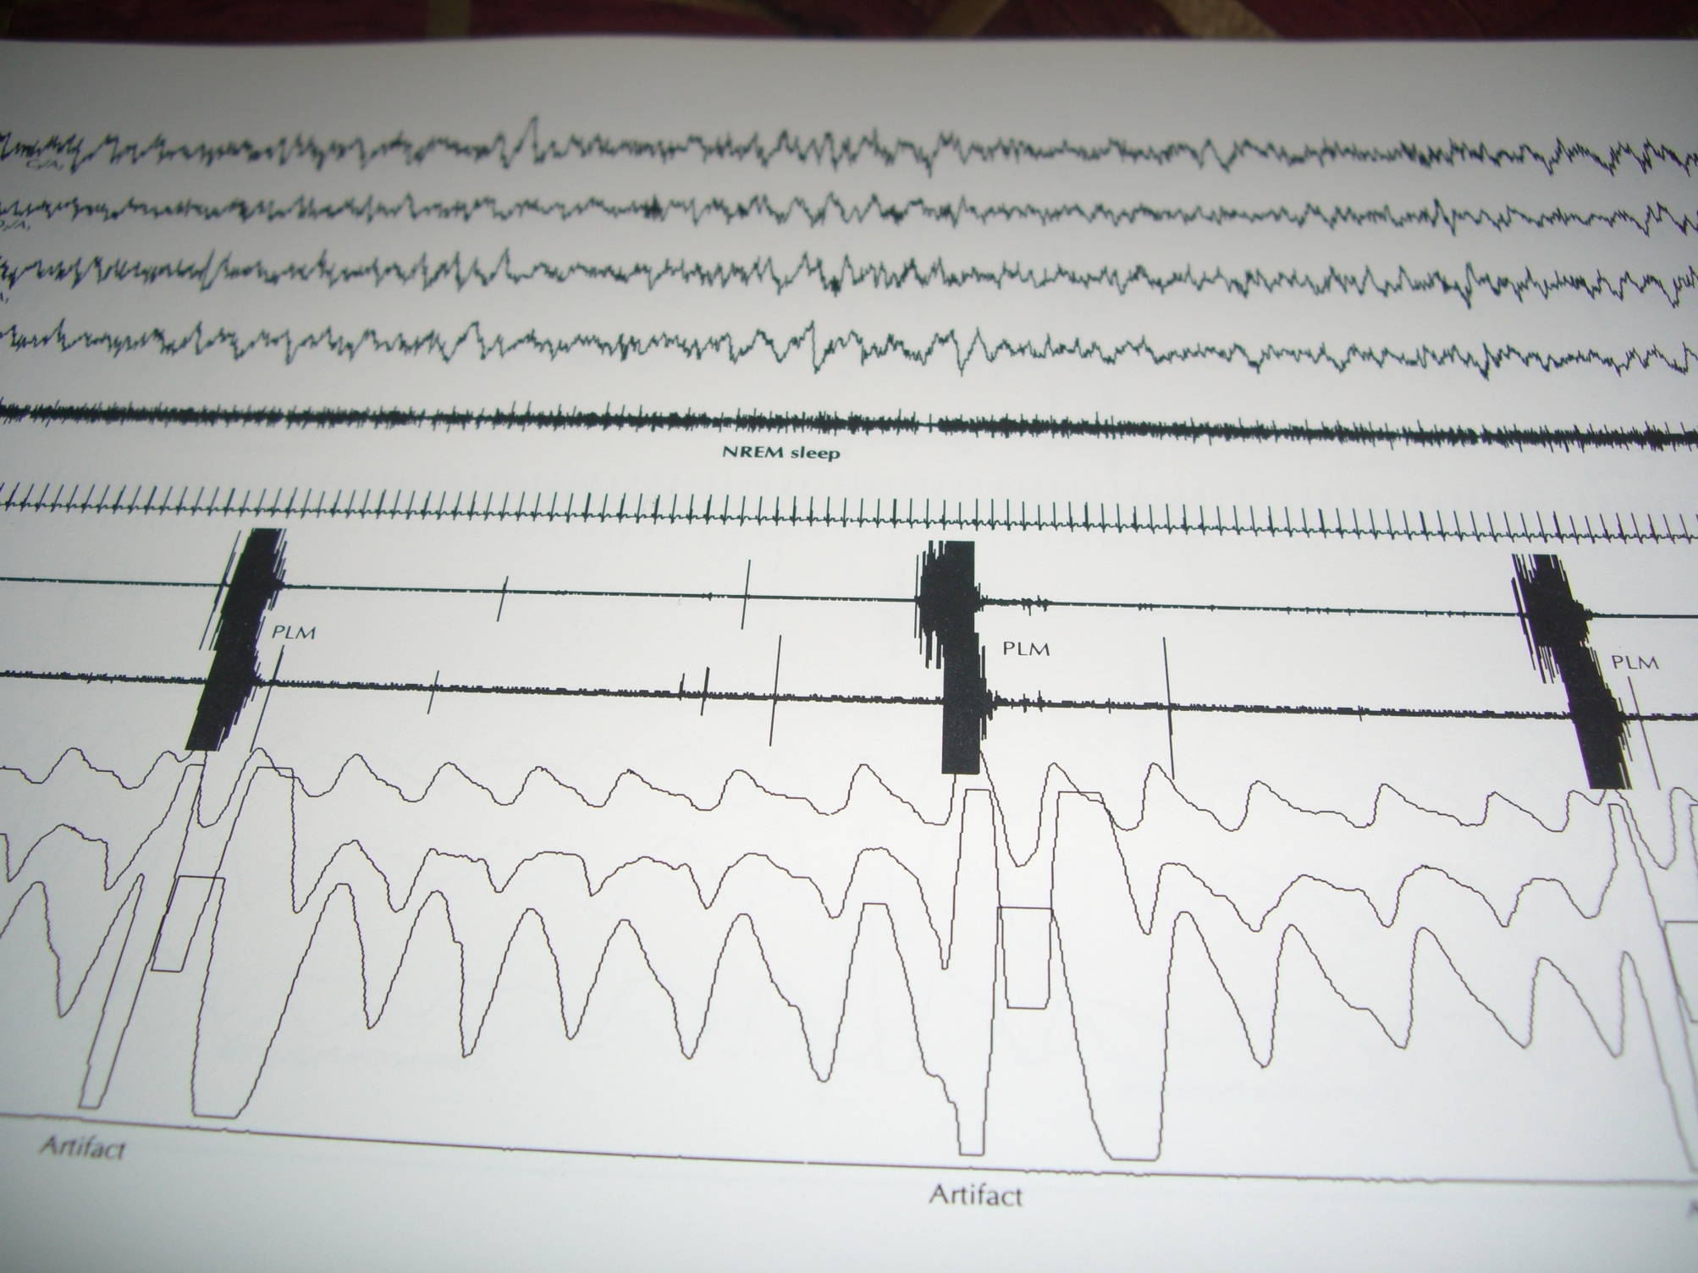

Slide 30
Management of INSOMNIA :
PHARMACOTHERAPY
A) SELF-MEDICATION (OTC DRUGS):
e.g. Anti-histaminics, Melatonin, Herbal (Valerian, Kava, Natra dose, Passiflora)
B) NEWER BENZODIAZEPINES: selective, short-acting, e.g.Estazolam..
C) BZ AGONISTS:
--- Zolpidem (Stilnox, Ambien) (MR) --- Zaleplon (Sonata, Siesta) ( ext. release II)
--- Zopiclone (Ximovan )
--- Es-Zopiclone (Lunesta)

Slide 31
Management of INSOMNIA
D) Newer Ads:
--- SARIs: Nefazodone, Trazodone..
--- NASSA: Mirtazapine..
E) DRUGS recently present or in DEVELOPMENT :
--- Neuro-active steroids e.g.Ganaxolone
--- H3 Agonists
--- Orexin antagonists (Belsomra (Suvorexant )recently approved in 8/2014).
--- Selective MT1/MT2-receptor agonists (Ramelteon (Rozerem) TAK-375 , Agomelatine ( with 5HTantagonist ) …
F) Others:
--- Selective GABA-A agonist (Gaboxadol) (III)
--- GABA potentiator (Indiplone) IR-MR
--- SGRI (Tiagabine)

Slide 32
Management of INSOMNIA
Early clinical trials : - Other GABA A compounds eg neurosteroids -Intra-nasal & subligual forms eg Zolpidem (I) , Trizolam (II)… -5HT2 a/c antagonists : Eplivanserine / Emirtazapine (II)… -Other MT agonists eg Enol 3 IPA -Other psychotropics : Quetiapine, Olz…

Slide 33
Management of INSOMNIA
-H3-agonist , H1-antagonist -CRF-antagonist (I) -Adenosine enhancers ? -Others : CB1, …………. CCK , …………. Cytokines e.g. IL6 , …………. Neuropeptide S…….

Slide 34
Management of INSOMNIA
PIPELINE INSOMNIA DRUGS-2018 :
1-GABA-A >>>> Zaleplon CR / EVT-201 (phaseII)
2-Orexin >>>> Filorexant / Leborexant (phase-III) (Eisai) / ACT541468 (phase-II)…
3-H1 >>>> LY2624803
4-5HT2A >>>> ITI-007 / Lumateperone (phaseII)
5-Melatonin/5HT1A >>> Piromelatin
6-Prolonged release melatonin
7-Testimelteon ( Pediatric sleep & CR disruption?)

Slide 35
What is an “ideal” hypnotic ?
Suitable for all types of insomnia
Suitable for short & long term use
NO : dependence / hangover / cognitive dysfunction….
Sleep promoting i.e. improves quality not only quantity of sleep / improves SWS
Minimal drug interaction & adverse effects

Slide 36
Suitability | Daytime sleepiness | Dependence potential | PSG profile | Long term use | Mechanism | Drug
Short term use , especially if associated with anxiety | Yes ( depending on T1/2) | Yes | REM & SWS suppressant | Not recommended | GABA-A receptor / non-selective ( alpha 1,2,3 &5) | BZs
1st line treatment for 1ry insomnia | Less likily ( depending on T1/2) | Less likely | Less REM suppressant | Approved for some e.g.eszopiclone | GABA-A PAMs ( alpha 1 subunit) | Z-hypnotics
Under testing | Less | Less | As Z-hypnotics | ? | Alpha 1 selective GABA-APAM | Indiplon (IR & CR)
Under testing | Less | Less | ? | ? | Selective delta-GABA-A receptor PAM ( modulate extrasynaptic GABA) | Gaboxadol (Neuro-steroids )
Especially for sleep onset & CR | Less | No | Normalizing ? | can be used | MT1 / MT2 agonist | Ramelteon
Chronic & 2ry insomnia | + / - | No | SWS promoting | Can be used | 5HT2 A & C antagonists | AD ( Trazadone , nefazadone Mirtazepine )

Slide 37
SUITABILITY | SLEEP PROMOTING EFFECT ( SWS) | DAYTIME SEDATION | DEPENDENCE
Short term / anxiety | -ve | +++ | +++ | GABA-ergic
Initial insomnia, CR disrupton… | + | + / - | -ve | Melatonergic
Chronic / secondary / elderly.. | +++ | + / - | -ve | Serotonergic
Secondary , situational , with caution in elderly | + / - | +++ | -ve | Histaminergic

Slide 38
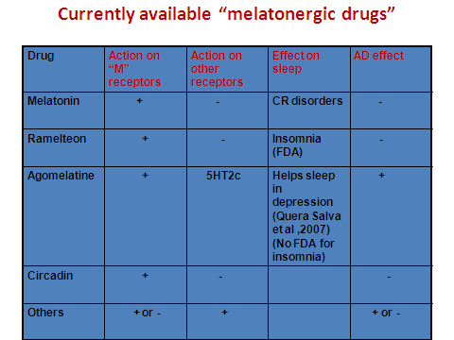

Slide 39
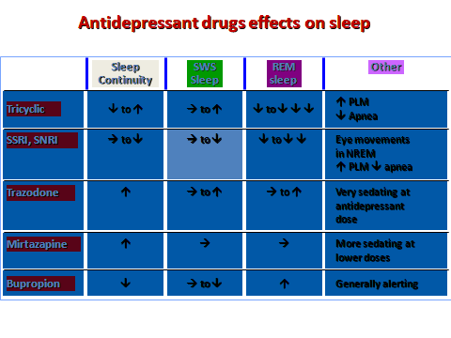

Slide 40
Management of INSOMNIA :
NON-PHARMACOLOGICAL
(A)-Behavioral & Cognitive Techniques ( SCT,SRT,relaxation, CBT…) (B)-Light Therapy. (C)-Transcranial – electro stimulation. (D)- GOOD SLEEP HYGEINE : ( food,beverage,exercise,bed behaviour & sleep atmosphere,sleep/wake habits…)

Slide 41
D.D.OF HYPERSOMNOLENCE
SUBJECTIVE –LONG SLEEPERS.
CIRCADIAN RHYTHM DISRUPTION.
INSOMNIA ??
PHYSICAL/ SUBSTANCE INDUCED.
PRIMARY SLEEP DISORDER : ---Narcolepsy ---Sleep apnea ---PLMS ---Idiopathic.
PSYCHIATRIC AETIOLOGY.

Slide 42
Management of OSAS
1) CPAP / BiPAP
2) Modafinil and Armodafinil.
3) Surgery ( UPPP operation & others )
4) New techniques in surgery.
5) Wt loss
6) Dental appliances

Slide 43
Updates in Management of OSAS
The following drugs are FDA-approved for use in OSAS :
1-Zolpidem.
2-Ramelteon.
3-Modafinil (Provigil) & Armodafinil (Nuvigil).
4-All of the above.
5-None of the above.

Slide 44
Updates in Management of OSAS
The following device(s) is (are) FDA-approved for management of OSAS :
1-CPAP.
2-BiPAP.
3-EPAP.
4-Al of the above.
5-(1) & (2) only.

Slide 45
Updates in Management of OSAS
The most recently FDA- approved treatment for OSAS :
1-BiPAP.
2-Adaptive Servo-Ventilator (ASV).
3-Inspire Implant Device (Pulse generator).
4-Armodafinil.

Slide 46
Recent FDA-Approvals for Sleep Apnea
In Spire ( Hypoglossal Nerve Stimulator / UAW stimulator) ( FDA-2014)
Expiratory Positive Airway Pressure (EPAP)
First Implant Device for “Central Sleep Apnea” –Phrenic nerve stimulator (FDA, 6/10/2017)
Meridian PM oral appliance ( 21/3/2018)
CURVE Positive Airway Pressure delivery system (FRESCA Medical) (26/6/2018)

Slide 47
Treatments in Development for Sleep Apnea
Dronabinol ( Cannabis-like) : centrally acting, first curative, rather than symptomatic drug? (Science Daily News, 30/11/2017)
Provent Therapy = Nasal application to deliver positive airway pressure
Z Quiet >>> for snoring
Other pillows, devices, implants….

Slide 48
UPDATES IN PHARMACOTHERAPY OF RLS
1) DOPAMINERGIC AGENTS: -- L-Dopa/ Pramipexole/ Pergolide -- Ropinirole/ Cabergoline (D2 agonist).
2) OPIOIDS: Propoxyphene
3) BZs: Clonazepam,Triazolam
4) ANTI-CONVULSANTS: -- Gabapentin,Cz,Lamotrigen,..
5) IRON.
6) OTHERS (e.g. Botulinum toxins??)

Slide 49
Sleep Medicine in Egypt : Current Status
Services :
1st Sleep Lab was in Early 1990s in Chest Department, Ain Shams University, then in 1992, Institute of Psychiatry, Ain Shams University
Nowadays, nearly in most University Hospitals (Cairo, Ain Shams, Alexandria, Tanta, Mansoura, Menufia, Assiut..), Military Hospitals, some Governmental Hospitals (Abbassia, Khanka..)
However, Sleep labs are NOT working properly in most of them!

Slide 50
Sleep Medicine in Egypt : Current Status
Private Sleep Study Centers are now expanding, but , honestly speaking, with few exceptions, most of them are just running commercial sleep studies, without proper service as sleep centers!
Few years ago, Egyptian Sleep Association was established, but still, its active role is far beyond expectations!

Slide 51
Sleep Medicine in Egypt : Current Status
Training & Certification :
-Training is very limited, only dependent on irregular courses in some university hospitals!
-No Certification is available till now!
-No standard system for training or certification of poly-somnographic technologists !
-Number of qualified or professional sleep specialists is VERY limited!

Slide 52
Sleep Medicine in Egypt : Current Status
Researches:
-Despite lack of proper service & training, more than 50 articles have been published in National & International Journals, including chapters in well-cited Books !
-Available psychometric tools, in Arabic !
International Representation :
-Representatives for North Africa & Middle East in WASM, had been selected from Egypt for the last 8 years, with fair representation in WASM meetings !

Slide 53
Sleep Medicine in Egypt : Current Status
Available Treatments :
-Deficiency in drugs for most sleep disorders !
-CPAP machines are fairly available
-Deficiency in other non-pharmacological treatment approaches, due to lack of qualified sleep psychologists

Slide 54
Sleep Medicine in Egypt : Future Hopes
Services & Training
Certification
Available Treatments
Research & publications

Slide 55
THANK YOU

